Slide 1
The Public Weighs In on Nation’s Child Welfare System: How Experience with the System Affects Attitudes and Perspectives
February 2024

Slide 2
BPC’s Child Welfare Initiative
In July 2023, Harris Poll and the Bipartisan Policy Center conducted a groundbreaking national survey to gauge public attitudes toward the U.S. child welfare system following the launch of BPC’s Child Welfare Initiative.
Building on recent state and federal reform efforts, BPC’s new Child Welfare Initiative will tackle key issues including preventing and responding to child neglect and abuse, adoption, foster care, and other areas with the goal of elevating a vision for protecting children and supporting families.
While experience with the system—through personal or nonpersonal involvement—certainly alters respondents’ views on aspects of the child welfare system, there is also a lot of agreement on the causes of abuse and neglect as well how the system should operate.

Slide 3
Methodology
Weighting:
Data are weighted to ensure results are projectable to the U.S. general population. Survey results are accurate to within ±2.9 percentage points using a 95% confidence level. This credible interval will be wider among subsets of the surveyed population of interest. Some responses may not add to 100% due to rounding or due to selection of responses not included in the chart including "unsure."
Audience:
2,013 U.S. adults age 18+
Mode: Conducted online in the U.S. by The Harris Poll on behalf of the Bipartisan Policy Center
Survey Timing:
15 minutes
Fielded from June 29 – July 19, 2023
Statistical Significance
Responses that were statistically significant are denoted with PI (personal involvement), NPI (non-personal involvement), or NI (no involvement) directly in the chart for the relevant bars.

Slide 4
Breakdown of Respondents by Lived Experience

Slide 5
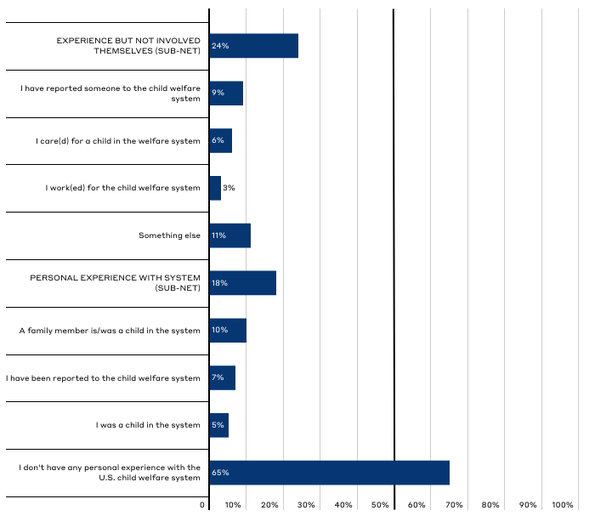
What personal experience, if any, do you have with the U.S. child welfare system?
24%
18%
Responses for total population. Respondents were able to select multiple responses so totals may add to more than 100%. As such, many respondents noted both personal and non-personal experience in the sample. Altogether, 35% of respondents had at least some experience with the system.
65%

Slide 6
Public Perceptions of Child Neglect and Abuse

Slide 7
Key Takeaways on Perceptions of Child Neglect and Abuse
Regardless of involvement with the system, Americans generally have similar views on why child abuse and neglect occurs, though:
Americans have similar views on parents who have been NEGLECTFUL, however, those with personal or non-personal system involvement are more likely to believe ABUSIVE parents can provide safe and nurturing care. [Slides 12, 13]
Those with personal or non-personal system involvement are more likely to believe abuse and neglect are not the parents’ fault, but the majority of all groups believe maltreatment is intentional. [Slide 12, 15]

Slide 8
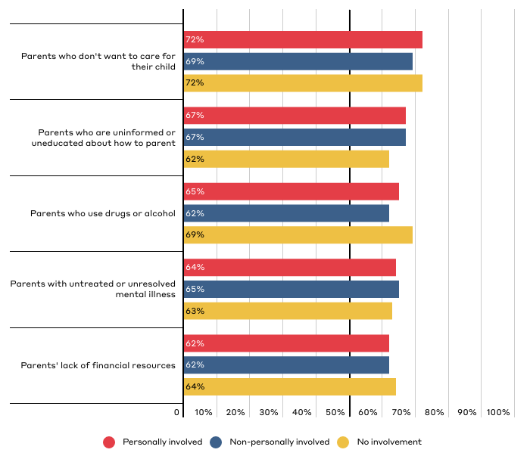
Which of the following factors do you think are significant contributors to why CHILD NEGLECT occurs?
Responses reflect top five responses for the total population broken down by party affiliation. Respondents could “select all that apply.” See Top Line Data for additional response options.

Slide 9
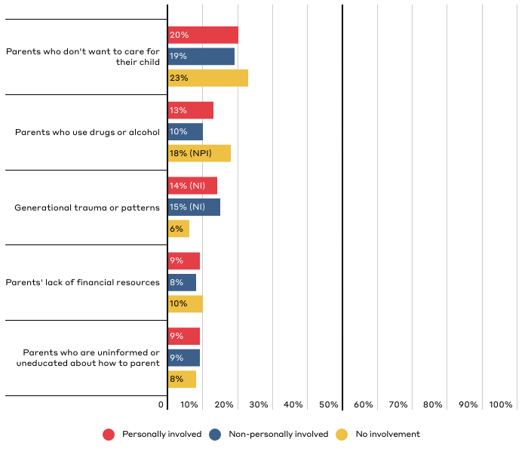
Which of the following factors do you think is typically the primary cause of CHILD NEGLECT?
Responses reflect top five responses for the total population broken down by party affiliation. See Top Line Data for additional response options.

Slide 10
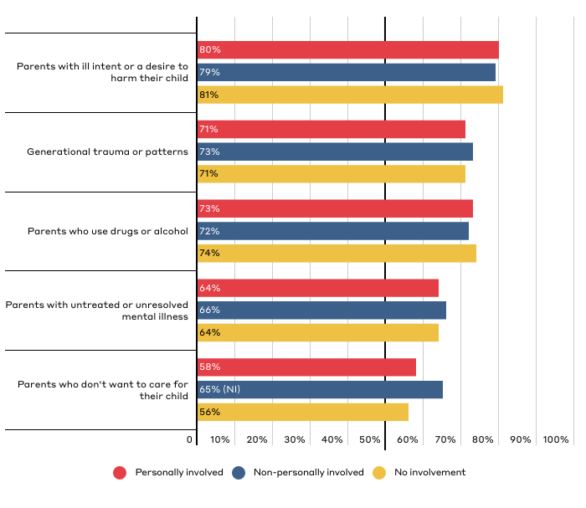
Which of the following factors do you think are significant contributors to why CHILD ABUSE occurs?
Responses reflect top five responses for the total population broken down by party affiliation. Respondents could “select all that apply.” See Top Line Data for additional response options.

Slide 11
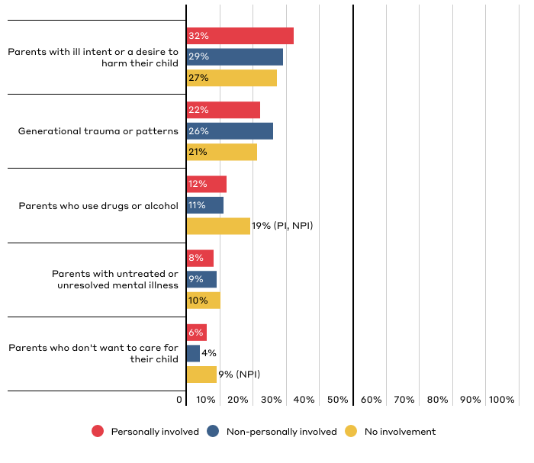
Which of the following factors do you think is typically the primary cause of CHILD ABUSE?
Responses reflect top five responses for the total population broken down by party affiliation. See Top Line Data for additional response options.

Slide 12
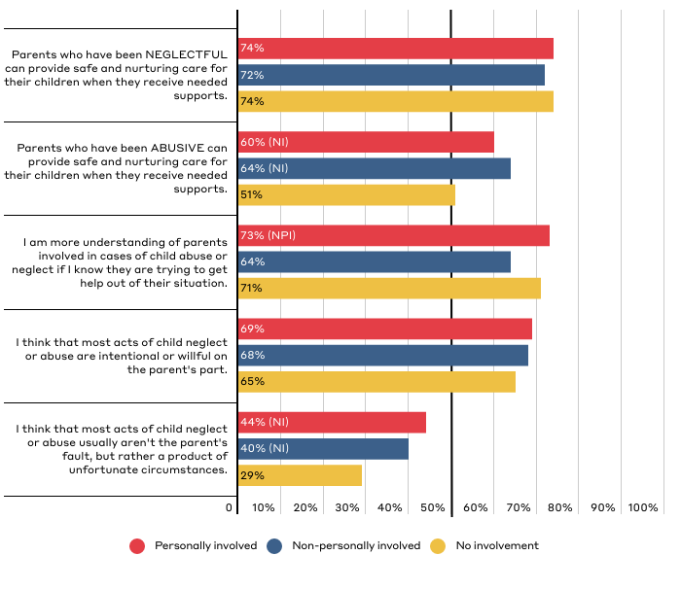
Public Perceptions of Parental Neglect and Abuse
Responses reflect those who “strongly agree” or “somewhat agree.”

Slide 13
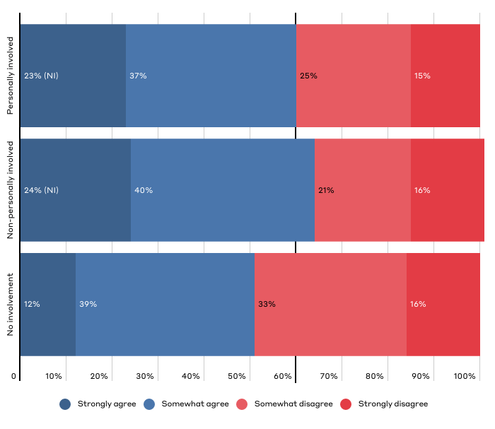
“Parents who have been ABUSIVE can provide safe and nurturing care for their children when they receive needed supports.”

Slide 14
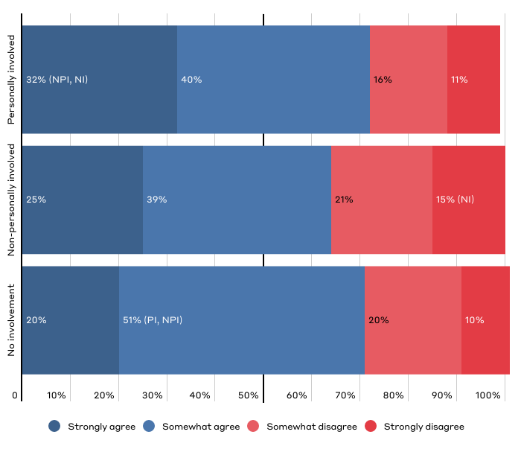
“I am more understanding of parents involved in cases of child abuse or neglect if I know they are trying to get help or find a way out of their situation.”

Slide 15
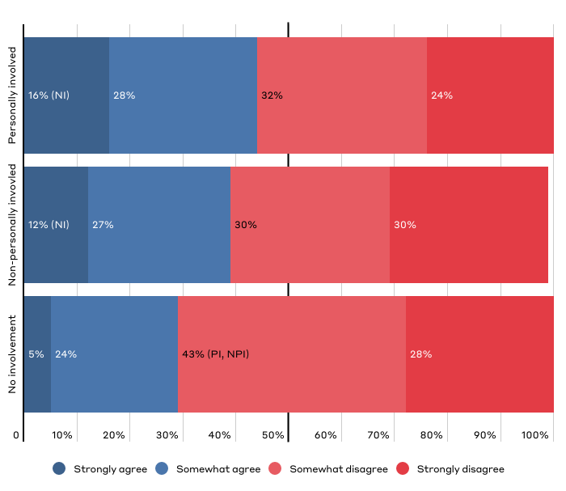
“I think that most acts of child neglect or abuse usually aren't the parent's fault, but rather a product of unfortunate circumstances.”

Slide 16
Public Perceptions of the Ideal U.S. Child Welfare System

Slide 17
Key Takeaways on Perceptions of the Ideal Child Welfare System
Experience with the system affected respondents' perspectives on the role of government in intervening in families' lives.
Those with non-personal system involvement are more likely to favor government’s interest in ensuring children’s well being over parents’ authority. [Slide 21]
However, those without system involvement are more likely to believe the system should favor protecting children over strengthening families. [Slide 23]

Slide 18
Key Takeaways on Perceptions of the Ideal Child Welfare System
Regardless of involvement with the system, Americans have similar views on how reporting and investigation of abuse and neglect should operate.
Americans agree they would need evidence of harm (not just risk of harm) to make a report. [Slide 24]
Americans agree on specific circumstances that warrant an investigation of abuse and neglect. [Slide 25, 26]
Americans believe that agencies should have evidence of harm (not just risk of harm) to investigate. [Slide 27]
When in doubt, Americans agree the system should err on the side of investigating reports. [Slide 28]

Slide 19
Key Takeaways on Perceptions of the Ideal Child Welfare System
System involvement affects Americans’ views of how other parts of the child welfare system should operate.
Those with personal and non-personal system involvement are more likely to favor keeping children with their family, though all groups lean this way. [Slide 29]
Those with non-personal system involvement are less likely to support giving parents time to address challenges and are the only group to support minimizing the time children remain in care when seeking a balance. [Slide 30]
A plurality of all groups believe the current policy gives parents enough time to address challenges, though those with system and personal involvement are more likely to believe that the current policy does not give parents enough time AND are also more likely to say it’s far too much time. [Slide 31]

Slide 20
Key Takeaways on Perceptions of the Ideal Child Welfare System
System involvement affects Americans’ views of how other parts of the child welfare system should operate.
Those with personal or non-personal system involvement are more likely to see community or religious organizations as more effective than government in responding to abuse and neglect. [Slide 22]
Americans have similar views on adoption, but those non-personally involved are more likely to believe adopted children should avoid contact with their biological family. [Slide 32]
Americans are extremely supportive of involving extended family regardless of system involvement. [Slide 33]

Slide 21
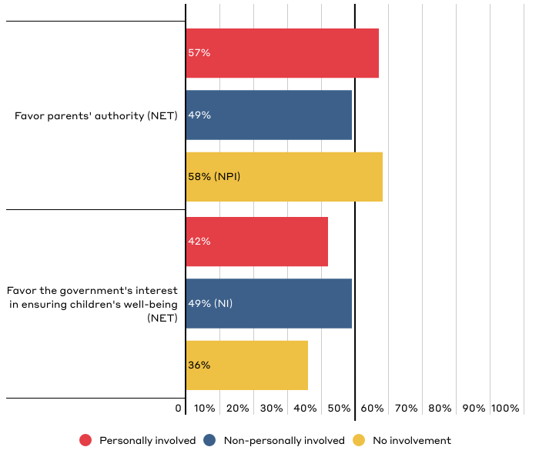
In balancing parents' authority with the government's interest in ensuring the well-being of children, should our country...?
Chart shows “net” (aggregate) of responses on a scale of 1-3 (favor parents' authority) to 4-6 (favor the government's interest in ensuring children's well-being). “Net” totals reflect that one response was selected on either side of the scale. Respondents could also select “not sure,” which is not reflected in the chart.

Slide 22
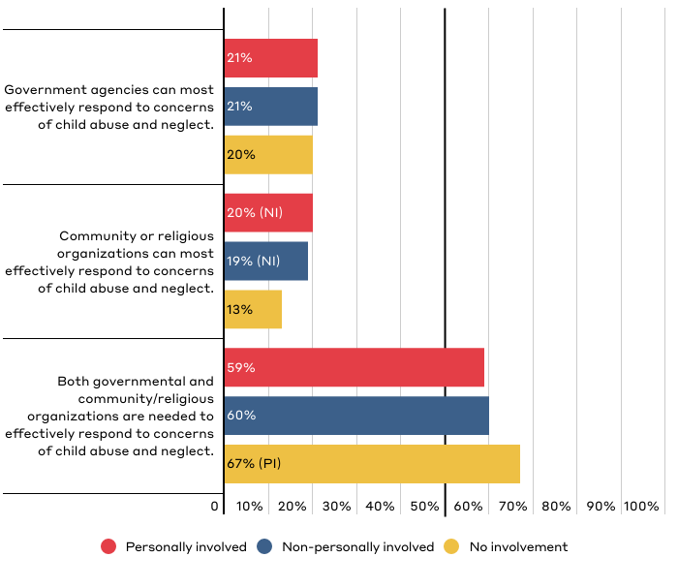
Which best reflects who you think is most effective at responding to concerns of child abuse and neglect?

Slide 23
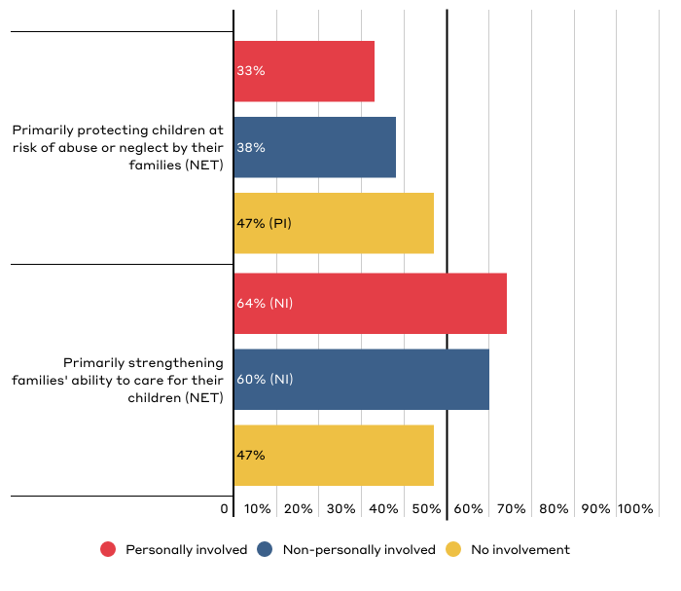
In an ideal world, which of the following reflects your position on the primary purpose of the child welfare system in this country?
Chart shows “net” (aggregate) of responses on a scale of 1-3 (favor protecting children) to 4-6 (favor strengthening families). “Net” totals reflect that one response was selected on either side of the scale. Respondents could also select “not sure,” which is not reflected in the chart.

Slide 24
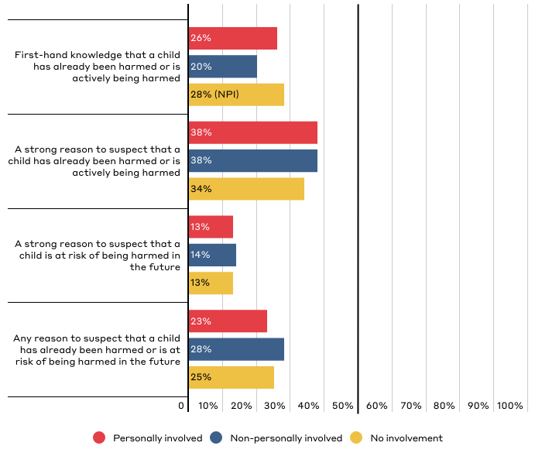
What is the minimum level of evidence you would need to feel comfortable filing a report where you suspected or knew that a child was being or had been abused or neglected?

Slide 25
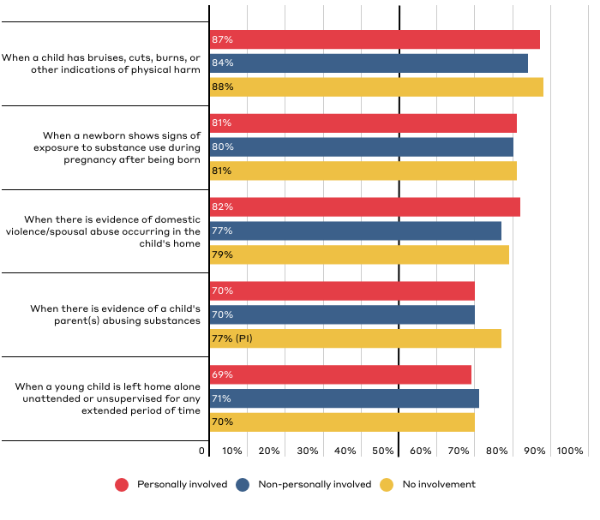
Do you believe that any of these scenarios should lead to an investigation by child welfare authorities?
Chart shows responses for “child welfare authorities should investigate.” Respondents were also given the option of “another government of community agency should offer support” or “not sure.”

Slide 26
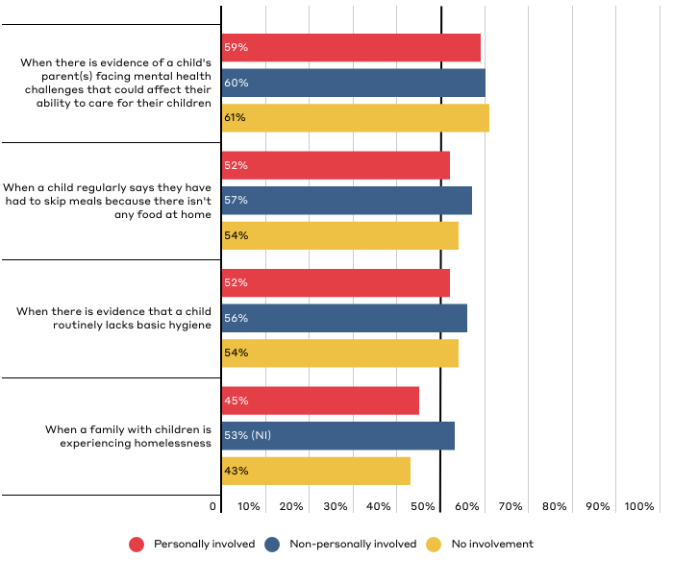
Do you believe that any of these scenarios should lead to an investigation by child welfare authorities? (continued)
Chart shows responses for “child welfare authorities should investigate.” Respondents were also given the option of “another government of community agency should offer support” or “not sure.”

Slide 27
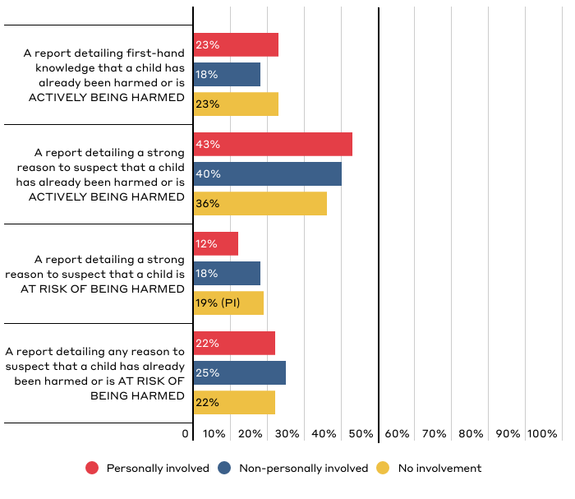
In your opinion, which of the following is the minimum amount of evidence that child welfare authorities should need to investigate?

Slide 28
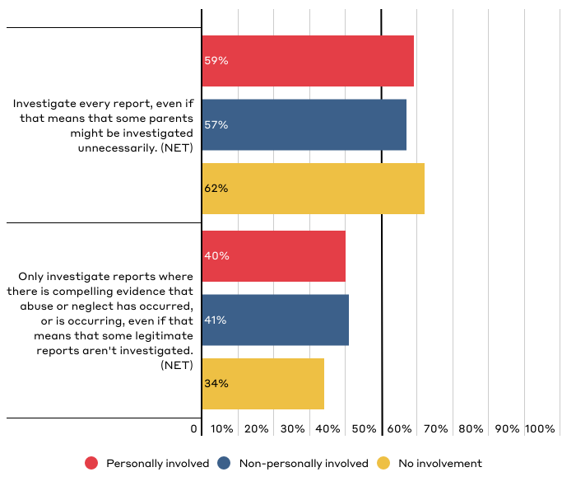
Which most closely reflects your position on how the U.S. child welfare system should decide whether to investigate reports of abuse or neglect?
Chart shows “net” (aggregate) of responses on a scale of 1 (investigate every report) to 6 (only investigate when there is compelling evidence). “Net” totals reflect that one response was selected on either side of the scale. Respondents could also select “not sure,” which is not reflected in the chart.

Slide 29
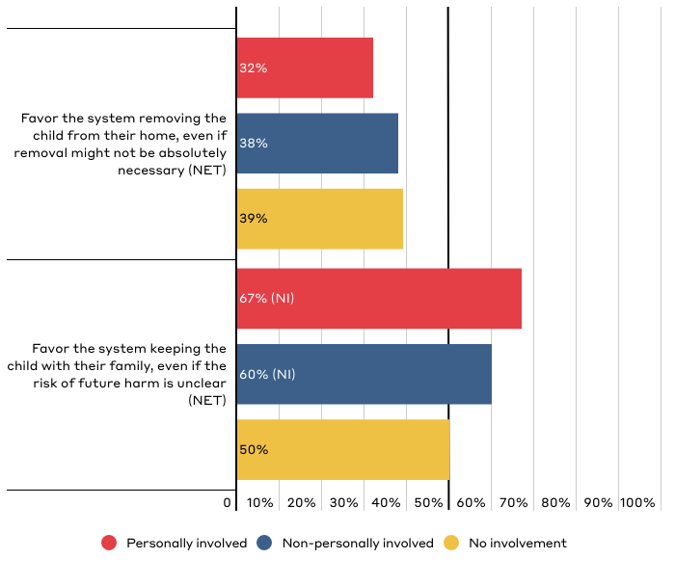
Which most closely reflects your position on how the U.S. foster care system should work when it comes to considering removal of a child?
Chart shows “net” (aggregate) of responses on a scale of 1-3 (with 1 being heavily favor removing child) to 4-6 (with 6 being heavily favor keeping child with family). “Net” totals reflect that one response was selected on either side of the scale. Respondents could also select “not sure,” which is not reflected in the chart.

Slide 30
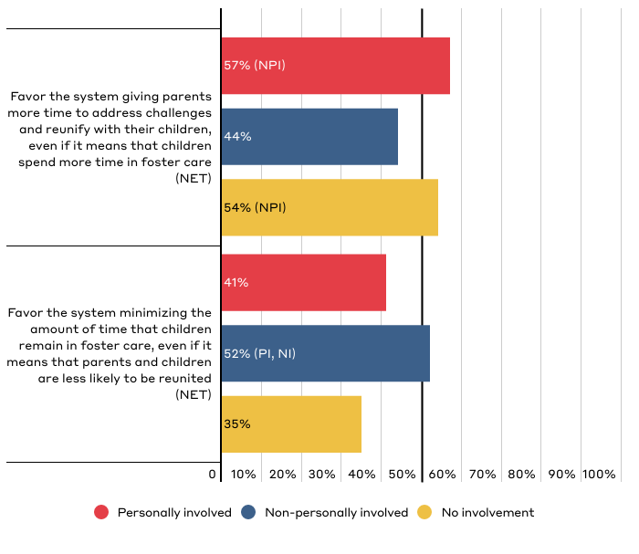
Which most closely reflects your position on how the U.S. foster care system should decide how long parents should be given to address challenges?
Chart shows “net” (aggregate) of responses on a scale of 1-3 (with 1 being heavily favor giving parents more time) to 4-6 (with 6 being heavily favor minimizing time in foster care). “Net” totals reflect that one response was selected on either side of the scale. Respondents could also select “not sure,” which is not reflected in the chart.

Slide 31
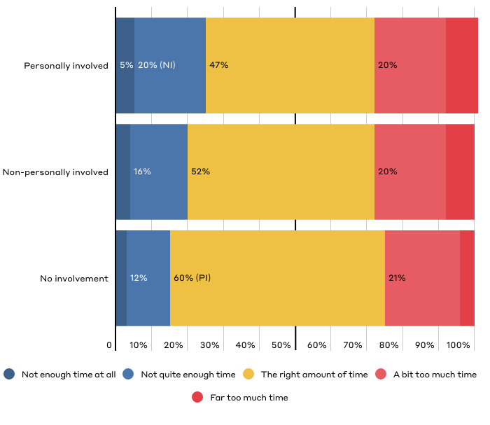
In your opinion, do you feel that approximately 15 months is the appropriate length of time for parents to show they are addressing issues that interfere with their ability to parent?

Slide 32
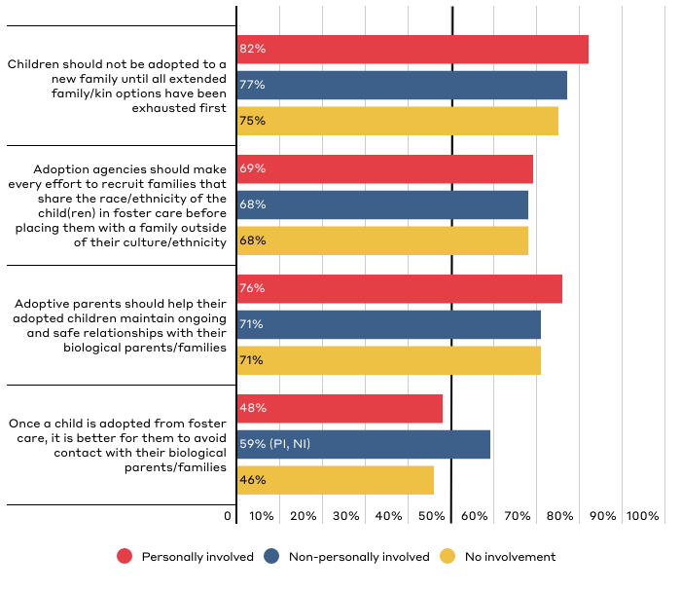
Public Perceptions of the U.S. Adoption System
Responses reflect those who “strongly agree” or “somewhat agree.”

Slide 33
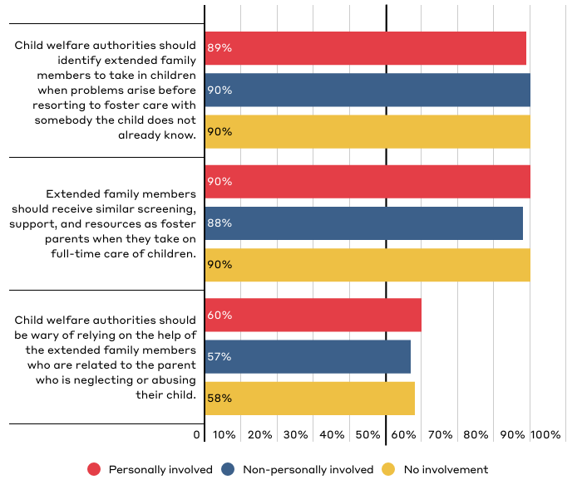
Public Perceptions on the Role of Extended Family
Responses reflect those who “strongly agree” or “somewhat agree.”

Slide 34
Public Perceptions of How the System Currently Functions

Slide 35
Key Takeaways on Perceptions of How the System Currently Functions
System involvement affects Americans’ perception of how the system is operating.
Those with personal and non-personal system involvement are much more familiar with system, but many of those without involvement have some familiarity as well. [Slide 37]
Those with personal and non-personal system involvement rely most on personal experience for their knowledge of the system, while those without system involvement rely most on news or media outlets. [Slide 38]
A majority of all groups believe that the system does more good than harm. [Slide 43]

Slide 36
Key Takeaways on Perceptions of How the System Currently Functions
System involvement affects Americans’ perception of how the system is operating.
Those with personal and non-personal system involvement are more likely to see the child welfare system as government overreach. [Slide 44, 46]
Those with personal system involvement are more likely to believe that child welfare system perpetuates oppression. [Slide 44, 45]
Those with personal system involvement are more likely than all others to see both socioeconomic and racial bias in decisions made by the child welfare system. [Slide 47]
Those with personal system involvement are more likely to believe that decisions to intervene made by the child welfare system are influenced by racial biases. [Slide 47, 49]

Slide 37
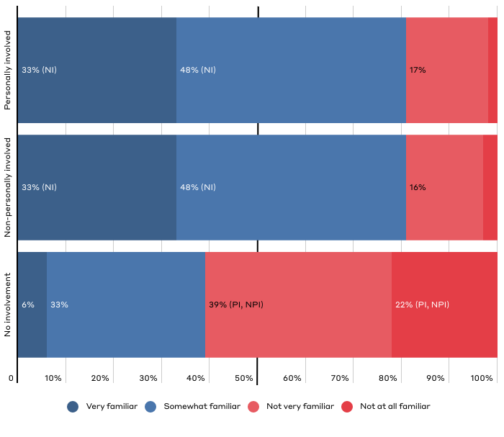
How familiar would you say you are with the child welfare system as a whole?

Slide 38
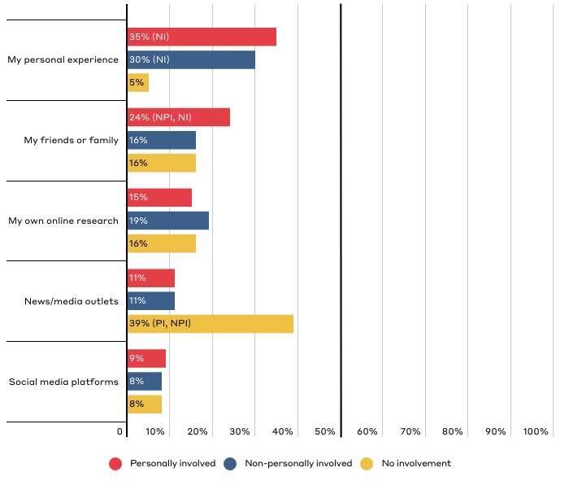
Which source have you relied on most to inform what you know about the current U.S. child welfare system?
Responses reflect top five responses for the total population broken down by party affiliation. See Top Line Data for additional response options.

Slide 39
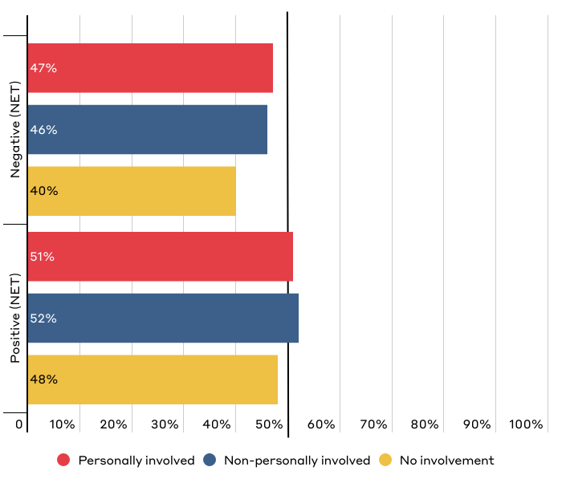
Overall, how positive or negative is your perception of the current U.S. child welfare system?
Chart shows “net” (aggregate) of responses on a scale of 1-3 (with 1 being very negative) to 4-6 (with 6 being very positive). “Net” totals reflect that one response was selected on either side of the scale. Respondents could also select “not sure,” which is not reflected in the chart.

Slide 40
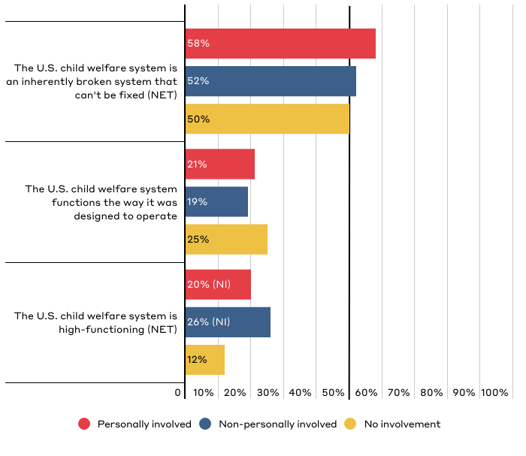
Overall, how would you rate how the current U.S. child welfare system functions?
Chart shows “net” of responses on a scale of 1-3 (with 1 being “The U.S. child welfare system is an inherently broken system that can't be fixed”), 4 (“The U.S. child welfare system functions the way it was designed to operate”), and 5-7 (with 7 being “The U.S. child welfare system is high-functioning”). “Net” totals reflect that one response was selected on either side of the scale. Respondents could also select “not sure,” which is not reflected in the chart.

Slide 41
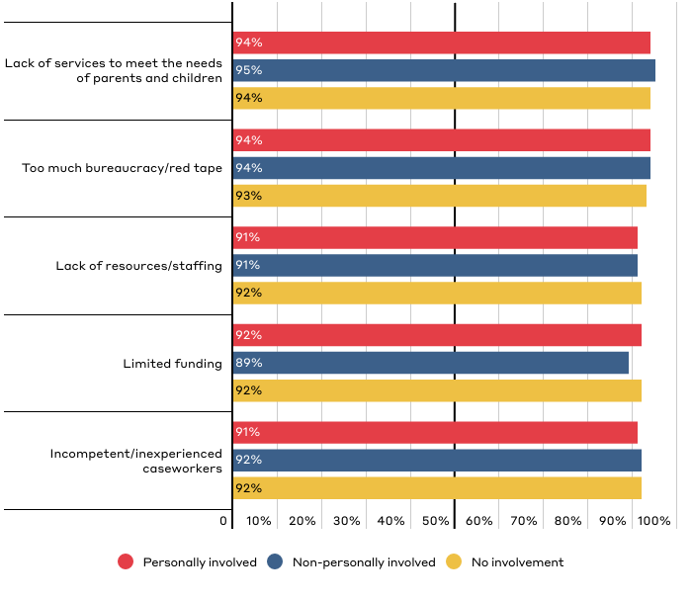
How much of a challenge do you see the following when it comes to the obstacles that the current U.S. child welfare system faces?
Responses for “somewhat of a challenge” and “a significant challenge.” Respondents could also answer with “not at all a challenge.”

Slide 42
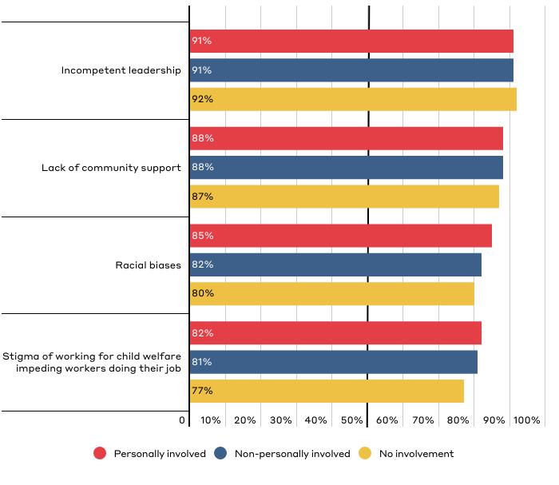
How much of a challenge do you see the following when it comes to the obstacles that the current U.S. child welfare system faces? (continued)
Responses for “somewhat of a challenge” and “a significant challenge.” Respondents could also answer with “not a challenge at all.”

Slide 43
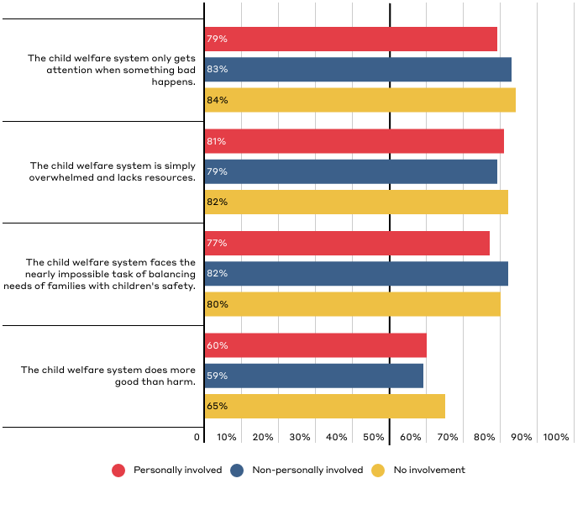
Public Perceptions of How the U.S. Child Welfare System Works
Responses for those who “strongly agree” and “somewhat agree.”

Slide 44
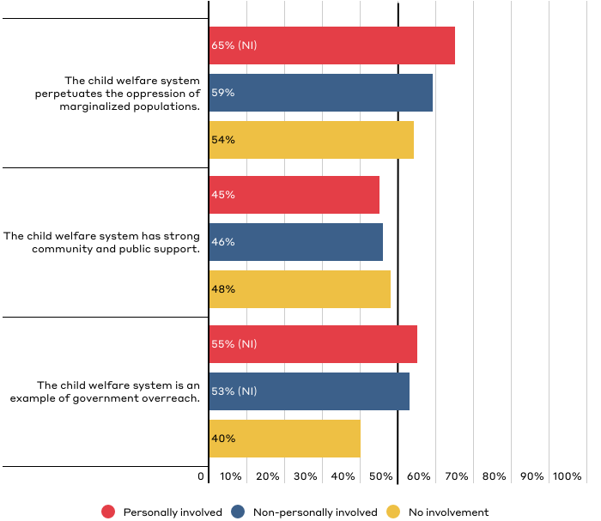
Public Perceptions of How the U.S. Child Welfare System Works (continued)
Responses for those who “strongly agree” and “somewhat agree.”

Slide 45
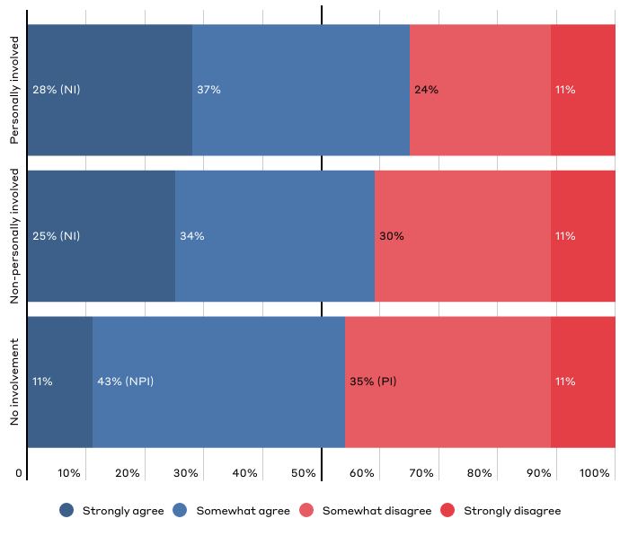
“The child welfare system perpetuates the oppression of marginalized populations.”

Slide 46
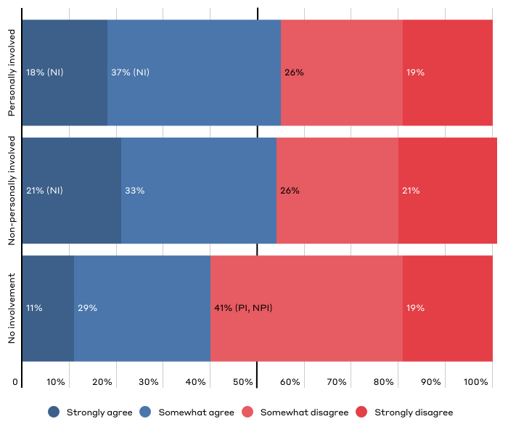
“The child welfare system is an example of government overreach.”

Slide 47
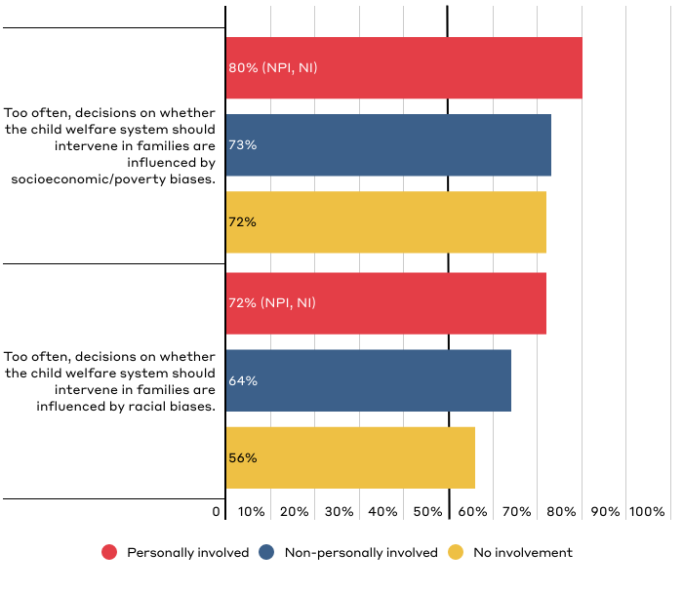
Public Perceptions of Bias in U.S. Child Welfare System
Responses for those who “strongly agree” and “somewhat agree.”

Slide 48
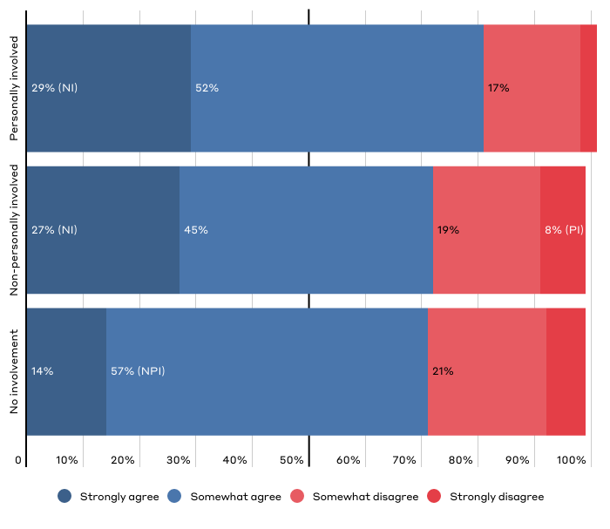
“Too often, decisions on whether the child welfare system should intervene in families are influenced by socioeconomic/poverty biases.”

Slide 49
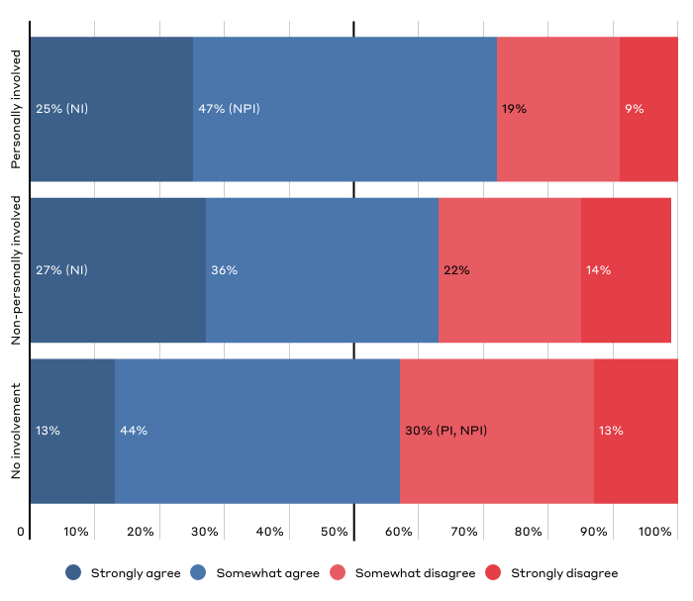
“Too often, decisions on whether the child welfare system should intervene in families are influenced by racial biases.”

Slide 50
Appendix: About the Child Welfare System
Respondents were given the following definition at the start of the survey:
The child welfare system is governed by a set of federal and state policies. The overall mission of federal, state, and local child welfare agencies is to provide for the safety, stability, and well-being of children who’ve been abused or neglected, or are at risk of abuse and neglect. Child welfare services vary from state to state but in general the main responsibilities include:
Receiving and investigating reports of possible child abuse and neglect.
Providing supportive services to families to prevent child abuse or neglect. These include mental health services, substance abuse treatment programs, and in-home parenting support, among others.
Providing an alternative home for children via foster or kinship care or a group home when it's determined (by courts) that they cannot remain safely at home.
Helping children leave foster care to be safely cared for by a permanent family, by reuniting them with their birth parents, or connecting them with relatives who serve as guardians or with adoptive families. This includes providing services to these families to promote safety and stability, so the child does not need to return to foster care.

Slide 51
Appendix: Key Definitions
Respondents were given the following definitions throughout the survey:
Child Neglect: Neglect is the failure to act to provide for a child’s needs leading to potential or actual harm, such as inadequate supervision, lack of protection from hazards, and unmet basic needs.
Child Abuse: Abuse is generally associated with nonaccidental physical injury, a pattern of behavior that impairs a child’s emotional development or sense of self-worth, or the coercion of any child to engage in any sexually explicit conduct.
Report: By reporting, we mean when a member of the public contacts child abuse and neglect hotlines, or child protective services offices, to alert them (i.e., submit a report) about suspected child abuse or neglect.
Investigate: By investigating, we mean the process of, once contacted with a report of child abuse or neglect, a caseworker being assigned to conduct an in-home visit to look for evidence supporting or refuting the allegations of child abuse or neglect.

Slide 52
Authors
Dane Stangler Managing Director, Strategic Initiatives
Rob Geen Fellow, Child Welfare Initiative
Emily Wielk Policy Analyst, Economic Policy Program
Media Inquiries
Luci Manning Senior Director of Communications LMANNING@BIPARTISANPOLICY.ORG
(202) 637-1467

