Slide 1
The Public Weighs in on Nation’s Child Welfare System: How Religion/Spirituality Affects Views and Perceptions
February 2024

Slide 2
BPC’s Child Welfare Initiative
In July 2023, Harris Poll and the Bipartisan Policy Center conducted a groundbreaking national survey to gauge public attitudes toward the U.S. child welfare system following the launch of BPC’s Child Welfare Initiative.
Building on recent state and federal reform efforts, BPC’s new Child Welfare Initiative will tackle key issues including preventing and responding to child neglect and abuse, adoption, foster care, and other areas with the goal of elevating a vision for protecting children and supporting families.
Our poll findings show some differences in responses among those who reported that religion plays a minimal vs. moderate vs. large role in their life, but overall, there is enormous common ground and shared values amongst respondents.

Slide 3
Methodology
Weighting:
Data are weighted to ensure results are projectable to the U.S. general population. Survey results are accurate to within ±2.9 percentage points using a 95% confidence level. This credible interval will be wider among subsets of the surveyed population of interest. Some responses may not add to 100% due to rounding or due to selection of responses not included in the chart including "unsure."
Audience:
2,013 U.S. adults age 18+
Mode: Conducted online in the U.S. by The Harris Poll on behalf of the Bipartisan Policy Center
Survey Timing:
15 minutes
Fielded from June 29 – July 19, 2023
Statistical Significance
Responses that were statistically significant are denoted with a MIN, MOD, LRG directly in the chart for the relevant bars.

Slide 4
Breakdown of Respondents by Religion/Spirituality

Slide 5
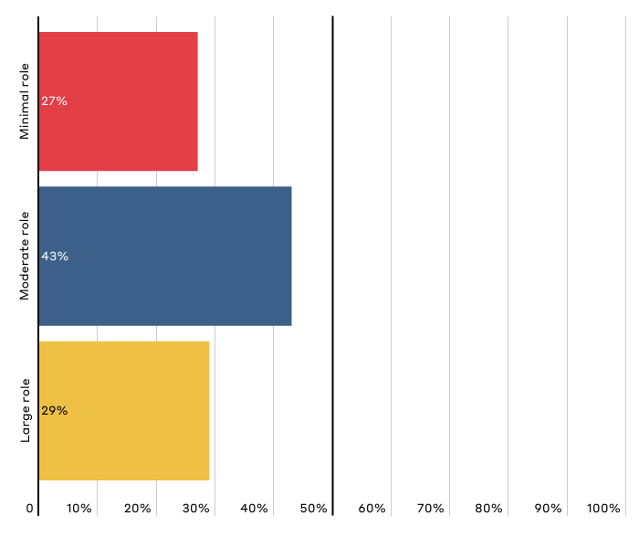
How big a role does your religion or spirituality play in your life?
Chart shows “net” (aggregate) of responses on a scale of 1-2 (minimal role) to 3-4 (moderate role), and 5-6 (large role). “Net” totals reflect that one response was selected within the scale options. Respondents could also select “not sure,” which is not reflected in the chart.

Slide 6
Public Perceptions of Child Neglect and Abuse

Slide 7
Key Takeaways on Perceptions of Child Neglect and Abuse
In many areas, Americans have similar views and perspectives on our nation’s child welfare system.
Americans hold similar views on why CHILD ABUSE occurs. [Slides 10, 11]
Americans believe that NEGLECTFUL parents can provide safe and nurturing care for their children when they receive needed supports. [Slide 12]
While most Americans view child abuse or neglect as intentional, this is particularly true of those who said religion plays a large and moderate role in their life. [Slide 12, 13]
While those who said religion plays a minimal role are more likely to believe that drugs and alcohol are a main cause of neglect, it is those who said religion plays a large role that believe investigation is warranted when a child is born substance exposed and when there is evidence of parental substance abuse. [Slide 9, Slide 22]

Slide 8
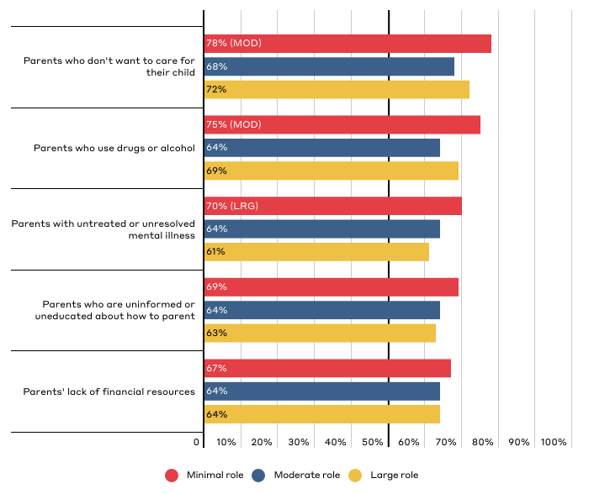
Which of the following factors do you think are significant contributors to why CHILD NEGLECT occurs?
Responses reflect top five responses for the total population broken down by party affiliation. Respondents could “select all that apply.” See Top Line Data for additional response options.

Slide 9
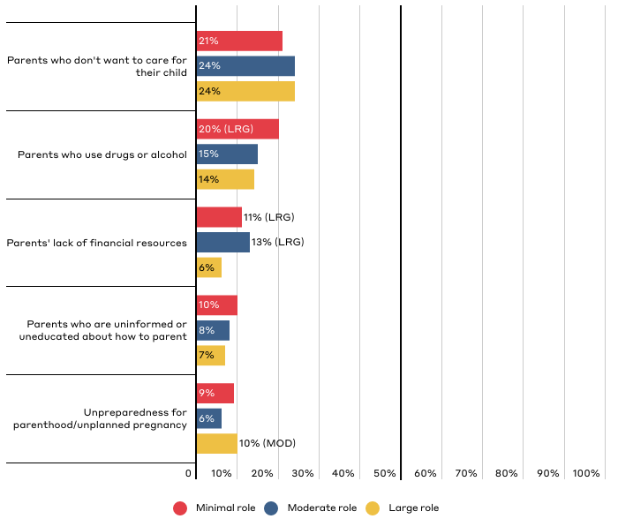
Which of the following factors do you think is typically the primary cause of CHILD NEGLECT?
Responses reflect top five responses for the total population broken down by party affiliation. See Top Line Data for additional response options.

Slide 10
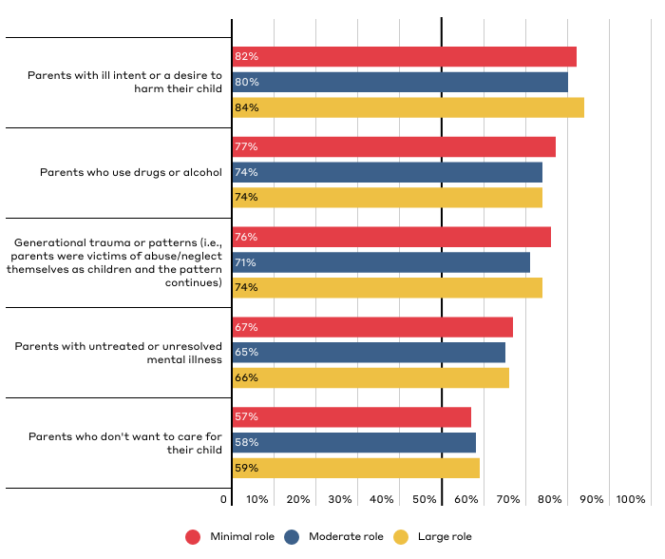
Which of the following factors do you think are significant contributors to why CHILD ABUSE occurs?
Responses reflect top five responses for the total population broken down by party affiliation. Respondents could “select all that apply.” See Top Line Data for additional response options.

Slide 11
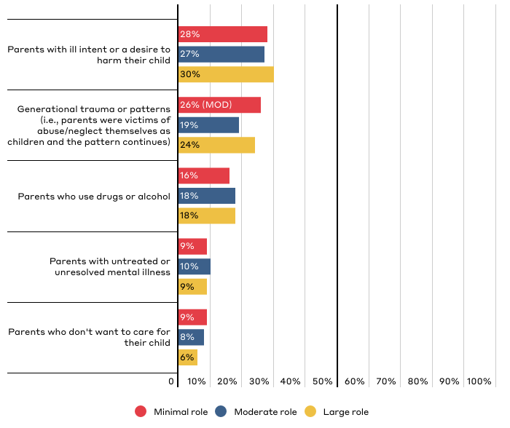
Which of the following factors do you think is typically the primary cause of CHILD ABUSE?
Responses reflect top five responses for the total population broken down by party affiliation. See Top Line Data for additional response options.

Slide 12
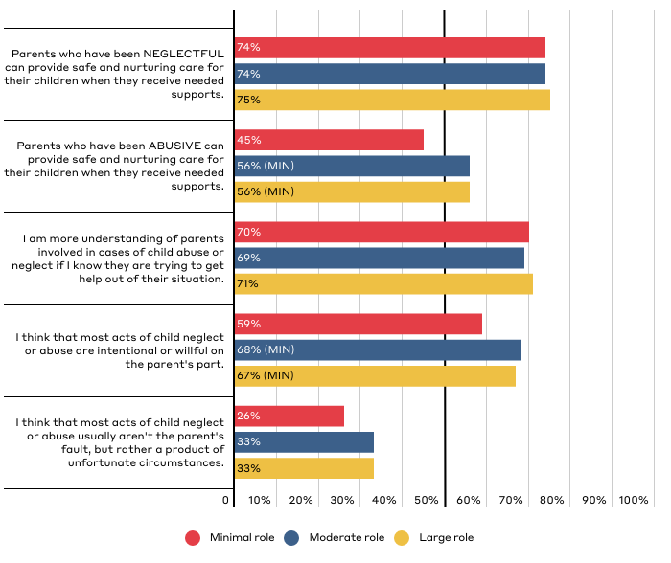
Public Perceptions of Parental Neglect and Abuse
Responses reflect those who “strongly agree” or “somewhat agree.”

Slide 13
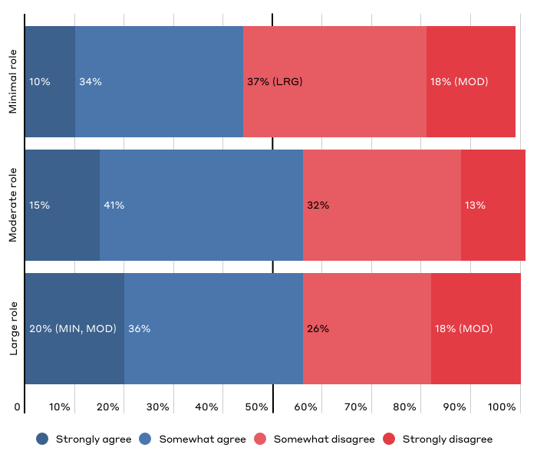
“Parents who have been ABUSIVE can provide safe and nurturing care for their children when they receive needed supports.”

Slide 14
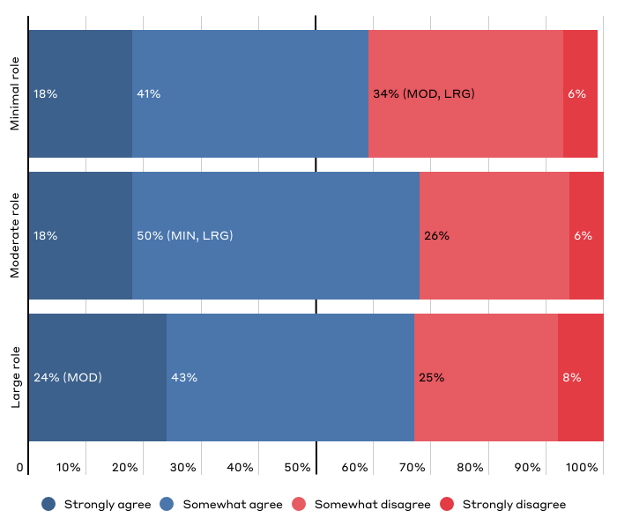
“I think that most acts of child neglect or abuse are intentional or willful on the parent's part.”

Slide 15
Public Perceptions of the Ideal U.S. Child Welfare System

Slide 16
Key Takeaways on Perceptions of the Ideal Child Welfare System
Those who are more religious are more likely to view birth parents and extended family with caution:
Those who said religion played a large role are more likely than those who said religion played a moderate role to believe the child welfare system should lean more towards protecting children than strengthening families. [Slide 20]
This is despite the fact that those who said religion played a large role are more likely to favor parents’ authority over the government’s interest in ensuring children’s well being. [Slide 18]

Slide 17
Key Takeaways on Perceptions of the Ideal Child Welfare System
Those who said religion played a large role are more likely to agree that adopted children are better off avoiding contact with their biological parents and suggest that agencies should be wary of engaging extended family. [Slide 29, 30]
Americans generally agree on when investigation is warranted; specifically, when in doubt, the system should: err on the side of investigating reports; favor keeping children with their family; and giving parents time to address challenges. [Slide 22, 23, 26, 27]

Slide 18
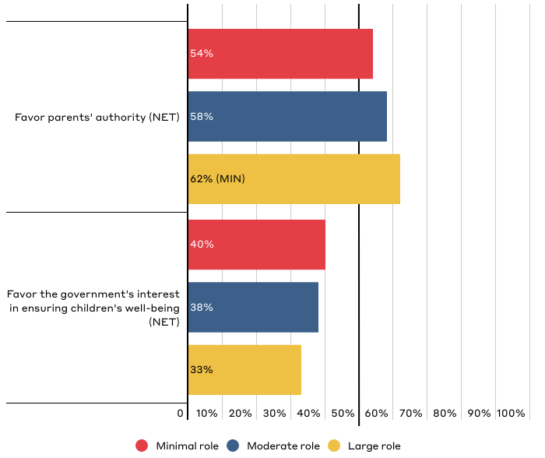
In balancing parents' authority with the government's interest in ensuring the well-being of children, should our country...?
Chart shows “net” (aggregate) of responses on a scale of 1-3 (favor parents' authority) to 4-6 (favor the government's interest in ensuring children's well-being). “Net” totals reflect that one response was selected on either side of the scale. Respondents could also select “not sure,” which is not reflected in the chart.

Slide 19
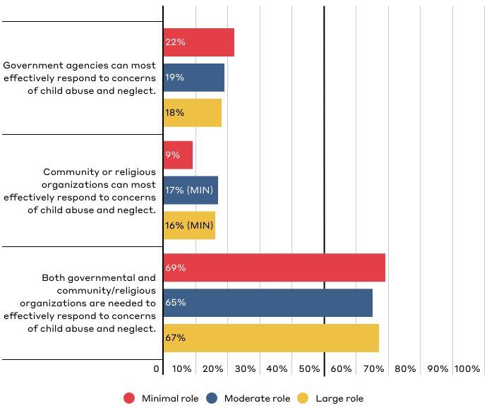
Which best reflects who you think is most effective at responding to concerns of child abuse and neglect?

Slide 20
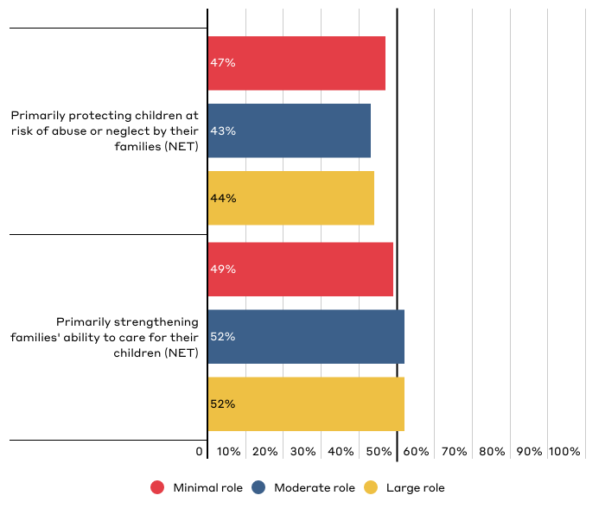
In an ideal world, which of the following reflects your position on the primary purpose of the child welfare system in this country?
Chart shows “net” (aggregate) of responses on a scale of 1-3 (favor protecting children) to 4-6 (favor strengthening families). “Net” totals reflect that one response was selected on either side of the scale. Respondents could also select “not sure,” which is not reflected in the chart.

Slide 21
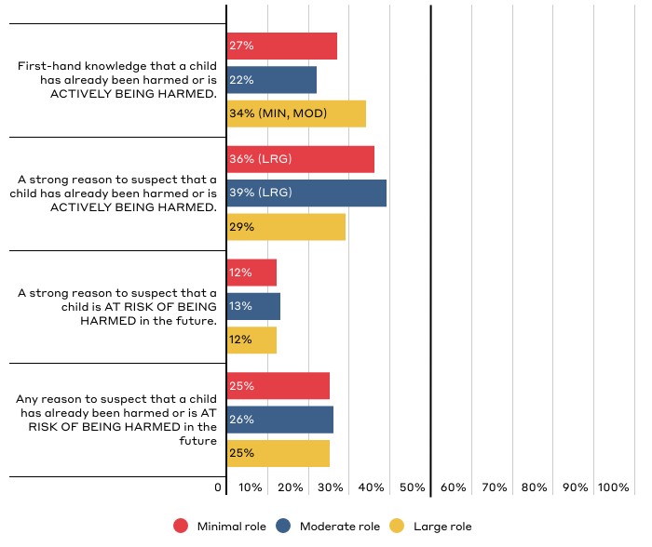
What is the minimum level of evidence you would need to feel comfortable filing a report where you suspected or knew that a child was being or had been abused or neglected?

Slide 22
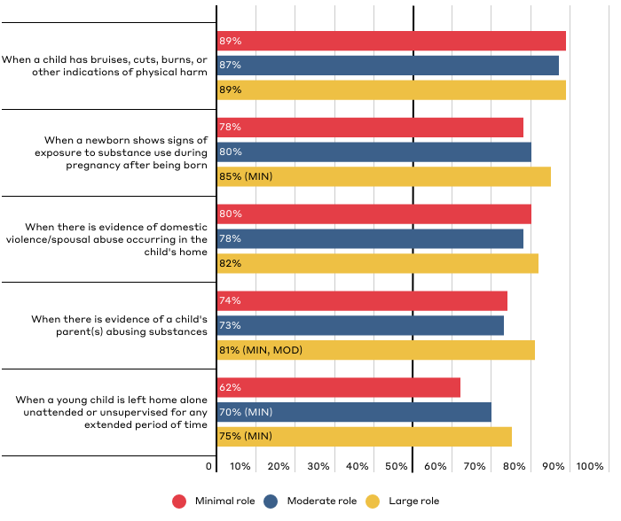
Do you believe that any of these scenarios should lead to an investigation by child welfare authorities?
Chart shows responses for “child welfare authorities should investigate.” Respondents were also given the option of “another government of community agency should offer support” or “not sure.”

Slide 23
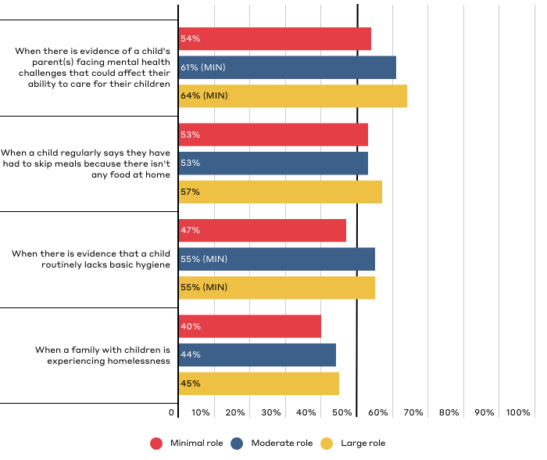
Do you believe that any of these scenarios should lead to an investigation by child welfare authorities? (continued)
Chart shows responses for “child welfare authorities should investigate.” Respondents were also given the option of “another government of community agency should offer support” or “not sure.”

Slide 24
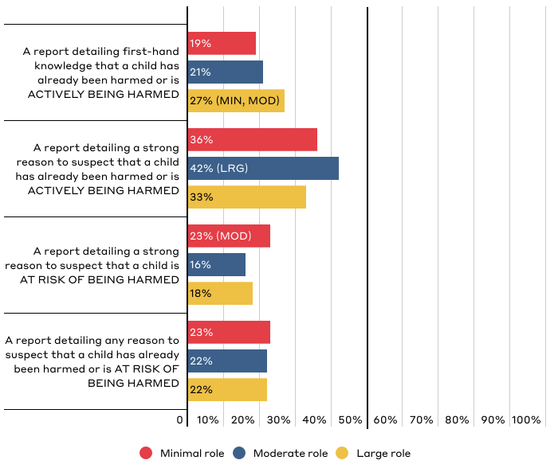
In your opinion, which of the following is the minimum amount of evidence that child welfare authorities should need to investigate?

Slide 25
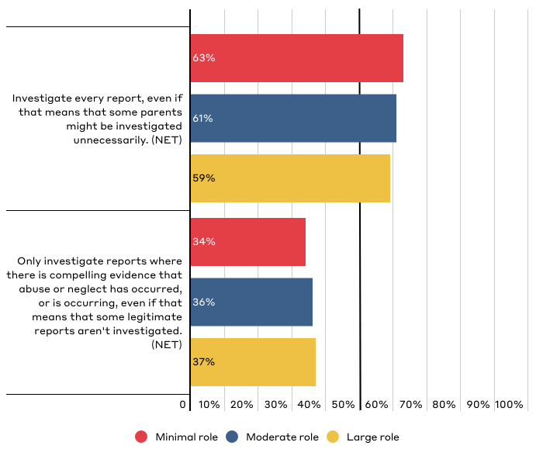
Which most closely reflects your position on how the U.S. child welfare system should decide whether to investigate reports of abuse or neglect?
Chart shows “net” (aggregate) of responses on a scale of 1 (investigate every report) to 6 (only investigate when there is compelling evidence). “Net” totals reflect that one response was selected on either side of the scale. Respondents could also select “not sure,” which is not reflected in the chart.

Slide 26
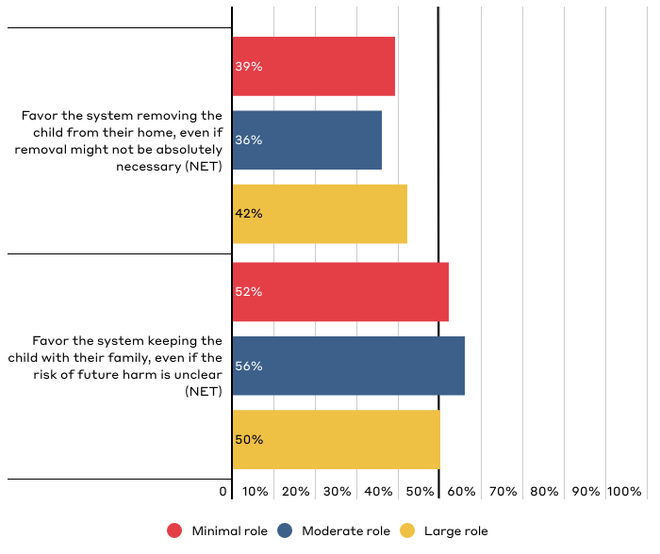
Which most closely reflects your position on how the U.S. foster care system should work when it comes to considering removal of a child?
Chart shows “net” (aggregate) of responses on a scale of 1-3 (with 1 being heavily favor removing child) to 4-6 (with 6 being heavily favor keeping child with family). “Net” totals reflect that one response was selected on either side of the scale. Respondents could also select “not sure,” which is not reflected in the chart.

Slide 27
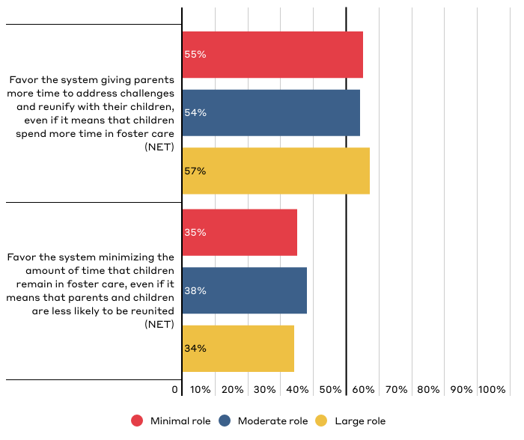
Which most closely reflects your position on how the U.S. foster care system should decide how long parents should be given to address challenges?
Chart shows “net” (aggregate) of responses on a scale of 1-3 (with 1 being heavily favor giving parents more time) to 4-6 (with 6 being heavily favor minimizing time in foster care). “Net” totals reflect that one response was selected on either side of the scale. Respondents could also select “not sure,” which is not reflected in the chart.

Slide 28
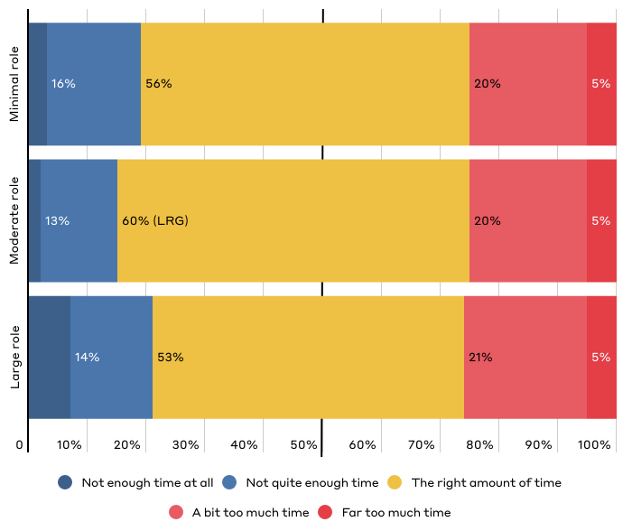
In your opinion, do you feel that approximately 15 months is the appropriate length of time for parents to show they are addressing issues that interfere with their ability to parent?

Slide 29
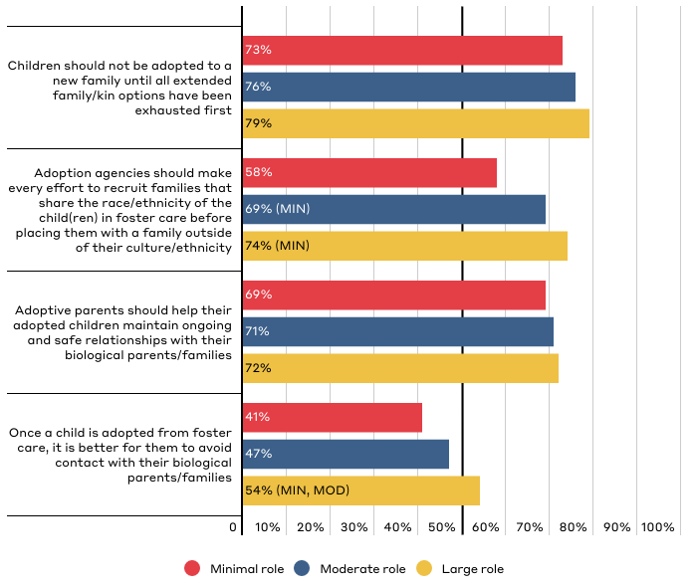
Public Perceptions of the U.S. Adoption System
Responses reflect those who “strongly agree” or “somewhat agree.”

Slide 30
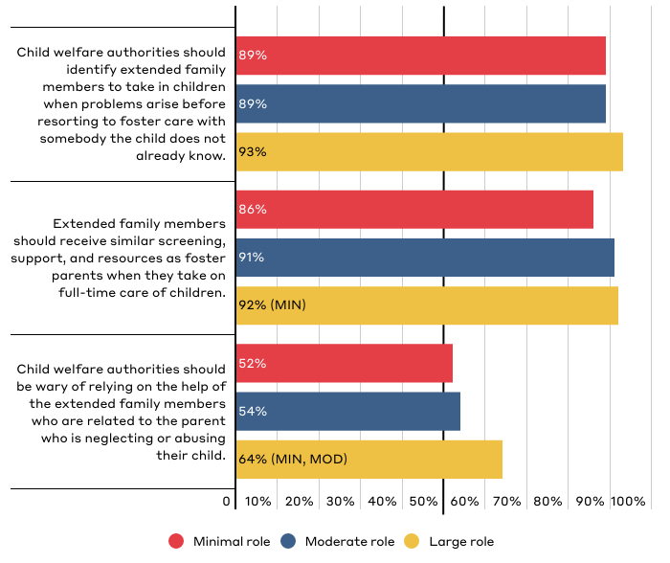
Public Perceptions on the Role of Extended Family
Responses reflect those who “strongly agree” or “somewhat agree.”

Slide 31
Public Perceptions of How the System Currently Functions

Slide 32
Key Takeaways on Perceptions of How the System Currently Functions
Those who are least religious are less likely to be familiar with the child welfare system and have somewhat different perspectives than those who are more religious.
Americans who said religion plays a minimal role have less familiarity with the child welfare system, which is likely because they are less likely to have experience with the system. [Slide 33]
Those who said religion plays a minimal role are more likely to have negative views of the systems and believe “system is broken.” [Slide 37]
Those who said religion plays a minimal role are more likely to believe that the system is simply overwhelmed and less likely to believe that it has strong community support or is an example of government overreach. [Slide 38, 39]

Slide 33
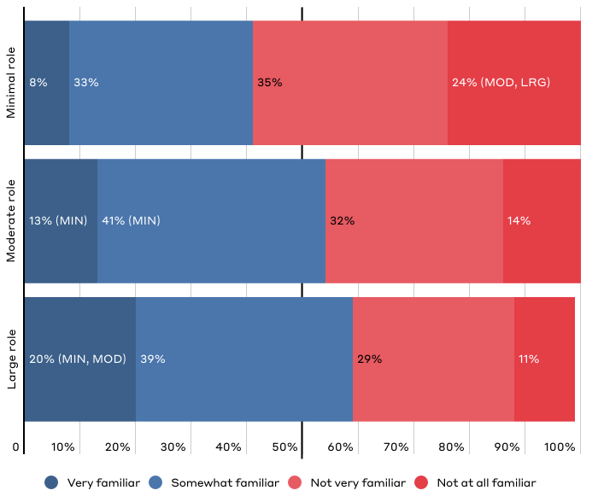
How familiar would you say you are with the child welfare system as a whole?

Slide 34
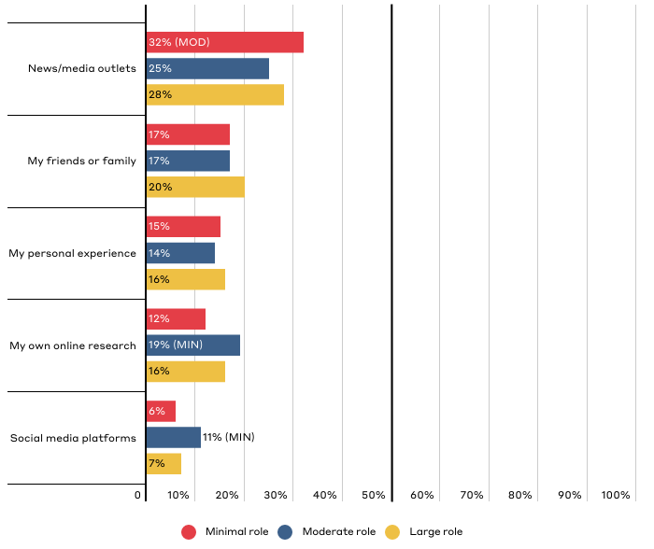
Which source have you relied on most to inform what you know about the current U.S. child welfare system?
Responses reflect top five responses for the total population broken down by party affiliation. See Top Line Data for additional response options.

Slide 35
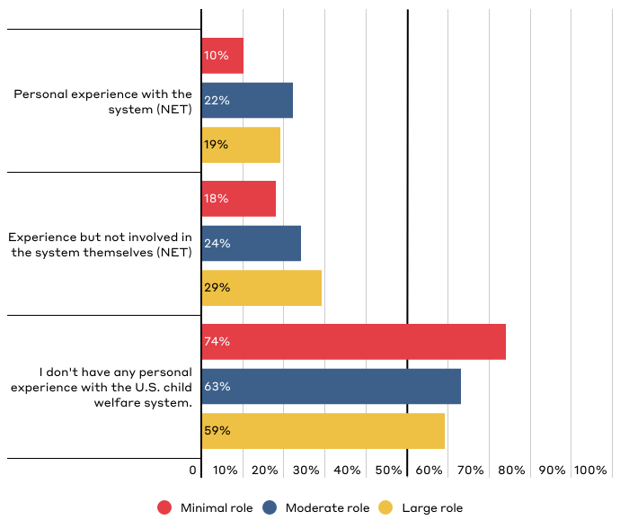
What personal experience, if any, do you have with the U.S. child welfare system?
“Personal experience with the system” includes being a child in the system, being reported to the system as an adult, or having a family member in the system. “Experience with the system but not involved themselves” includes caring for a child in the system, filing a report on a parent, working for the system, or something else. Respondents were able to “select all that apply” so responses add to over 100%.

Slide 36
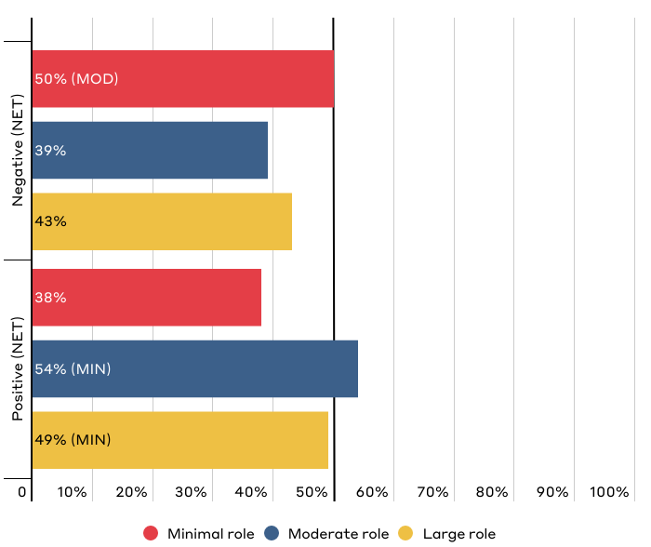
Overall, how positive or negative is your perception of the current U.S. child welfare system?
Chart shows “net” (aggregate) of responses on a scale of 1-3 (with 1 being very negative) to 4-6 (with 6 being very positive). “Net” totals reflect that one response was selected on either side of the scale. Respondents could also select “not sure,” which is not reflected in the chart.

Slide 37
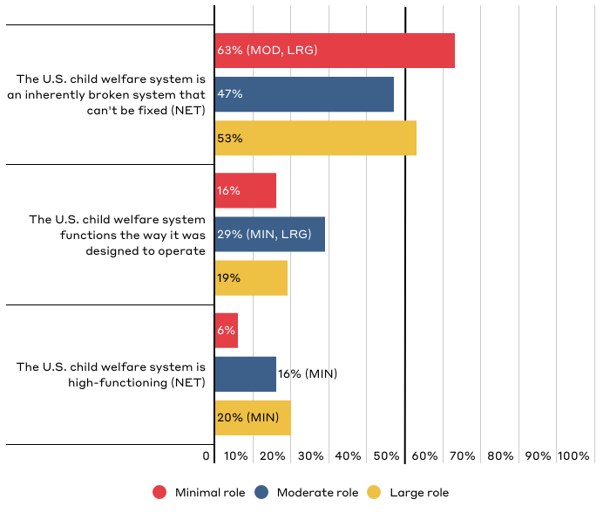
Overall, how would you rate how the current U.S. child welfare system functions?
Chart shows “net” of responses on a scale of 1-3 (with 1 being “The U.S. child welfare system is an inherently broken system that can't be fixed”), 4 (“The U.S. child welfare system functions the way it was designed to operate”), and 5-7 (with 7 being “The U.S. child welfare system is high-functioning”). “Net” totals reflect that one response was selected on either side of the scale. Respondents could also select “not sure,” which is not reflected in the chart.

Slide 38
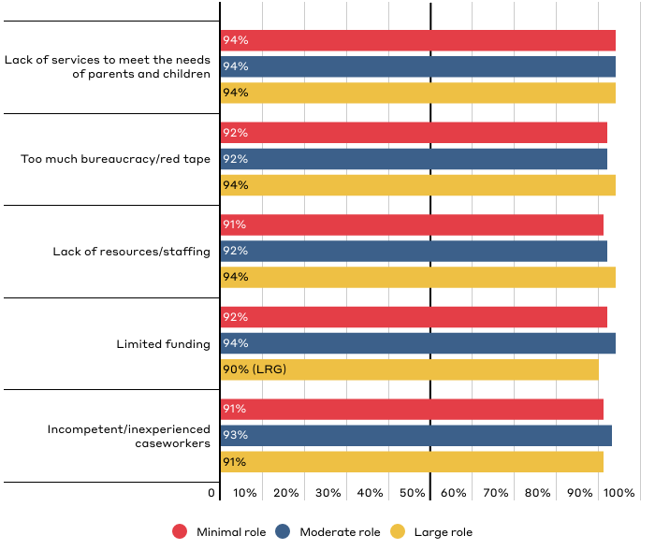
How much of a challenge do you see the following when it comes to the obstacles that the current U.S. child welfare system faces?
Responses for “somewhat of a challenge” and “a significant challenge.” Respondents could also answer with “not at all a challenge.”

Slide 39
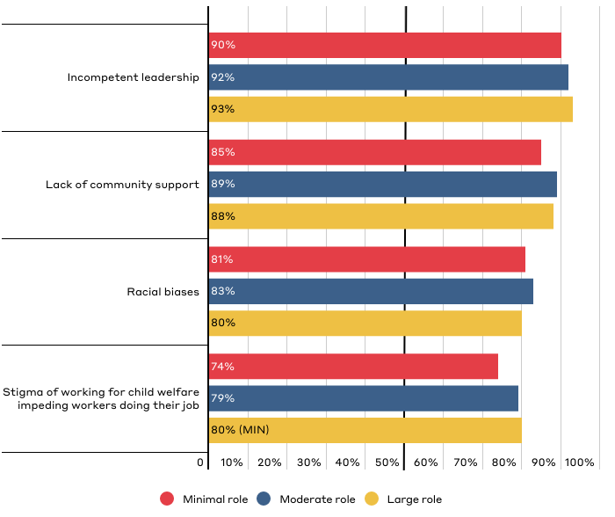
How much of a challenge do you see the following when it comes to the obstacles that the current U.S. child welfare system faces? (continued)
Responses for “somewhat of a challenge” and “a significant challenge.” Respondents could also answer with “not a challenge at all.”

Slide 40
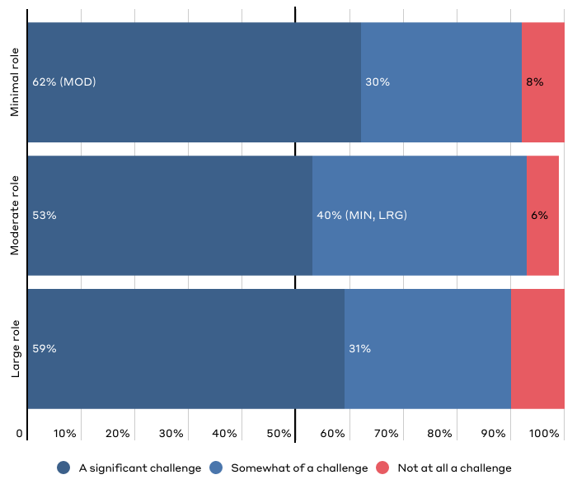
How much of a challenge do you see limited funding when it comes to the obstacles that the current U.S. child welfare system faces?

Slide 41
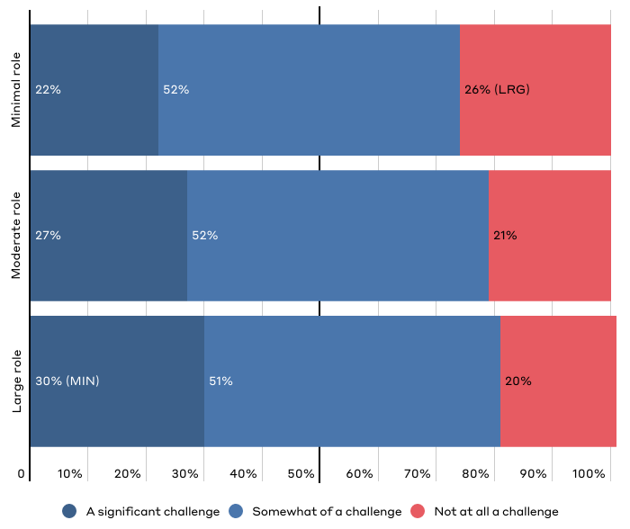
How much of a challenge do you see the stigma of working for child welfare being when it comes to the obstacles that the current U.S. child welfare system faces?

Slide 42
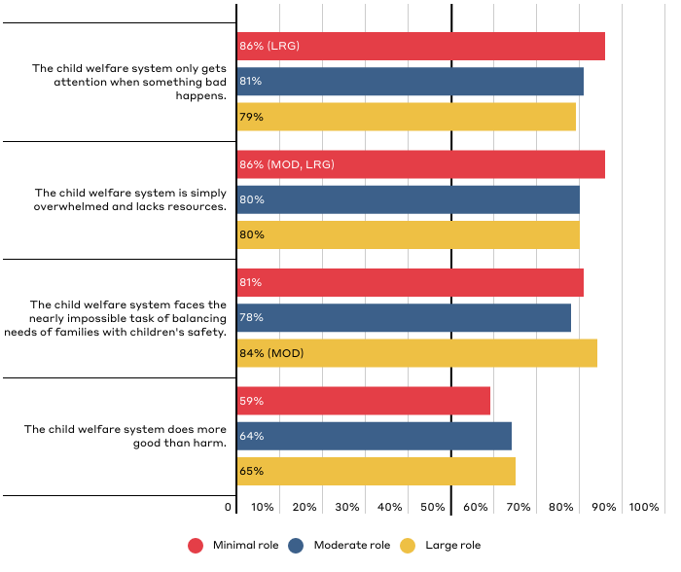
Public Perceptions of How the U.S. Child Welfare System Works
Responses for those who “strongly agree” and “somewhat agree.”

Slide 43
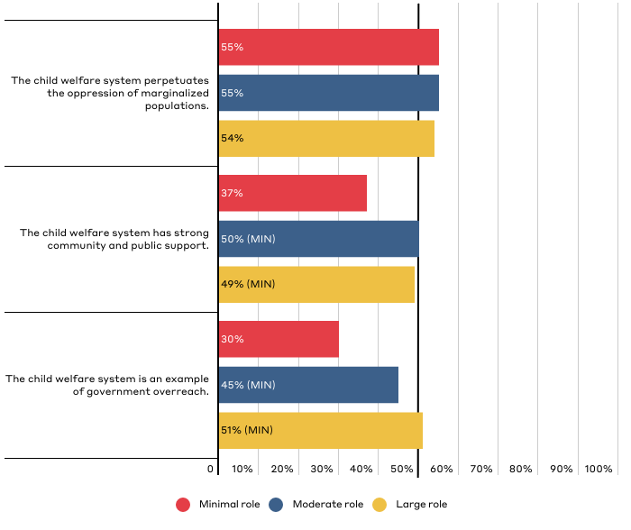
Public Perceptions of How the U.S. Child Welfare System Works
Responses for those who “strongly agree” and “somewhat agree.”

Slide 44
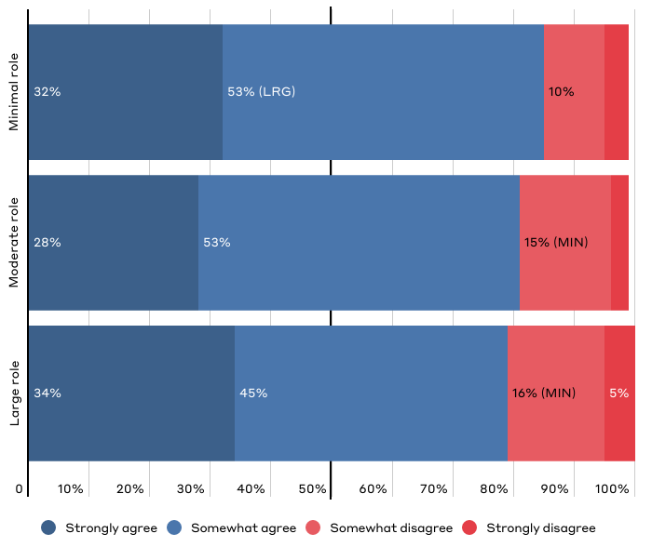
“The child welfare system only gets attention when something bad happens.”

Slide 45
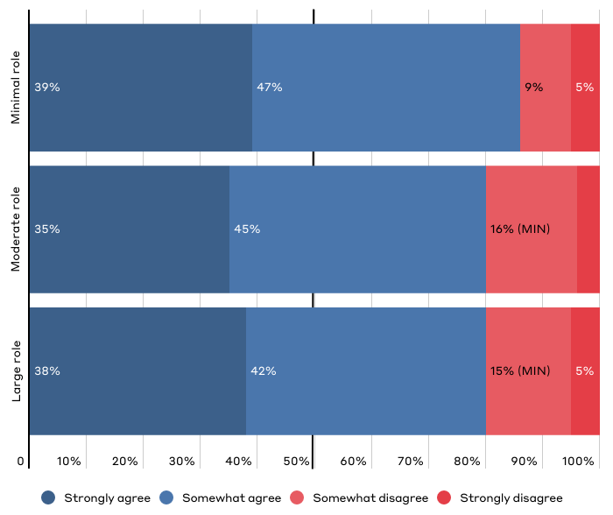
“The child welfare system is simply overwhelmed and lacks resources.”

Slide 46
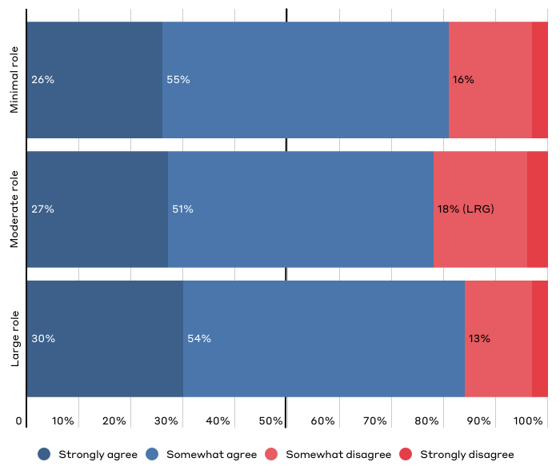
“The child welfare system faces the nearly impossible task of balancing the needs of families with the safety of children.”

Slide 47
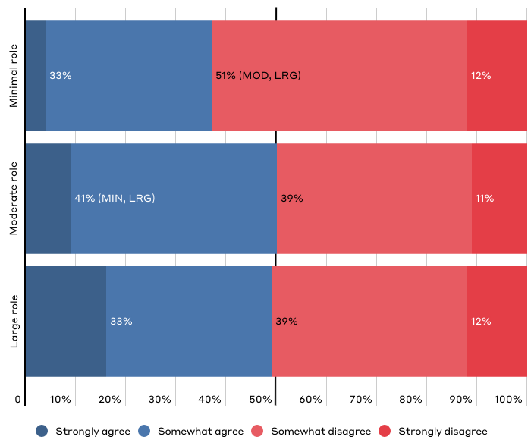
“The child welfare system has strong community and public support.”
4%
9% (MIN)
16%
(MIN, MOD)

Slide 48
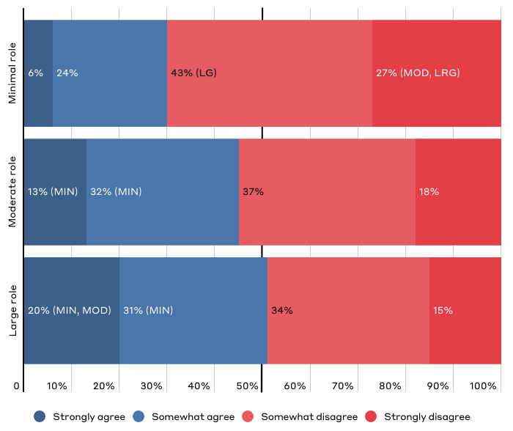
“The child welfare system is an example of government overreach.”

Slide 49
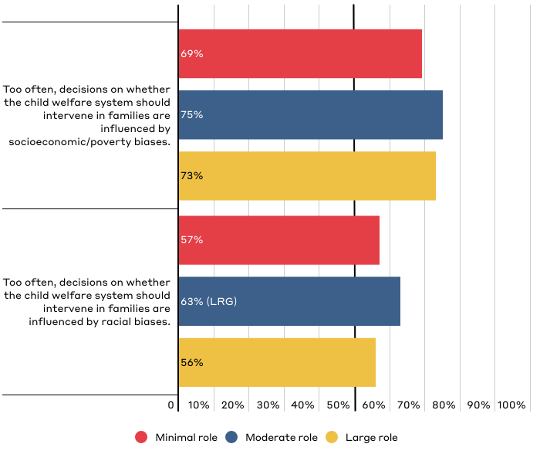
Public Perceptions of Bias in U.S. Child Welfare System
Responses for those who “strongly agree” and “somewhat agree.”

Slide 50
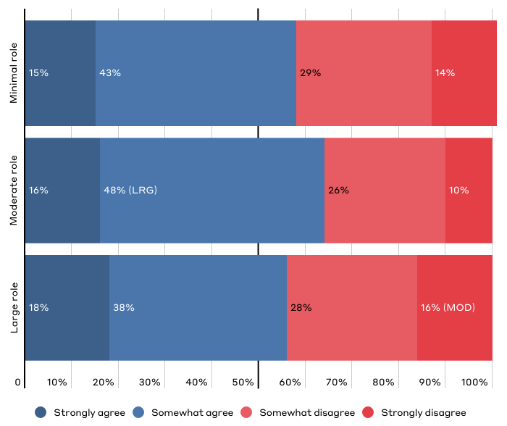
“Too often, decisions on whether the child welfare system should intervene in families are influenced by racial biases.”

Slide 51
Appendix: About the Child Welfare System
Respondents were given the following definition at the start of the survey:
The child welfare system is governed by a set of federal and state policies. The overall mission of federal, state, and local child welfare agencies is to provide for the safety, stability, and well-being of children who’ve been abused or neglected, or are at risk of abuse and neglect. Child welfare services vary from state to state but in general the main responsibilities include:
Receiving and investigating reports of possible child abuse and neglect.
Providing supportive services to families to prevent child abuse or neglect. These include mental health services, substance abuse treatment programs, and in-home parenting support, among others.
Providing an alternative home for children via foster or kinship care or a group home when it's determined (by courts) that they cannot remain safely at home.
Helping children leave foster care to be safely cared for by a permanent family, by reuniting them with their birth parents, or connecting them with relatives who serve as guardians or with adoptive families. This includes providing services to these families to promote safety and stability, so the child does not need to return to foster care.

Slide 52
Appendix: Key Definitions
Respondents were given the following definitions throughout the survey:
Child Neglect: Neglect is the failure to act to provide for a child’s needs leading to potential or actual harm, such as inadequate supervision, lack of protection from hazards, and unmet basic needs.
Child Abuse: Abuse is generally associated with nonaccidental physical injury, a pattern of behavior that impairs a child’s emotional development or sense of self-worth, or the coercion of any child to engage in any sexually explicit conduct.
Report: By reporting, we mean when a member of the public contacts child abuse and neglect hotlines, or child protective services offices, to alert them (i.e., submit a report) about suspected child abuse or neglect.
Investigate: By investigating, we mean the process of, once contacted with a report of child abuse or neglect, a caseworker being assigned to conduct an in-home visit to look for evidence supporting or refuting the allegations of child abuse or neglect.

Slide 53
Authors
Dane Stangler Managing Director, Strategic Initiatives
Rob Geen Fellow, Child Welfare Initiative
Emily Wielk Policy Analyst, Economic Policy Program
Media Inquiries
Luci Manning Senior Director of Communications LMANNING@BIPARTISANPOLICY.ORG
(202) 637-1467

