Slide 1
(Patient-Centered ) Comparative Effectiveness Research
Jodi B Segal, MD, MPH
Professor of Medicine, Epidemiology, Health Policy and Management
Johns Hopkins University School of Medicine and
Bloomberg School of Public Health

Slide 2
Doctor, should I be taking aspirin to prevent a heart attack? I know that I have some worrisome risk factors…

Slide 3
Should I?

Slide 4
We all want to get the right treatment to the right patient at the right time.
Comparative effectiveness research generates the evidence to inform the decisions that we make as clinicians, and as payers, and as patients.

Slide 5
A Definition of Comparative Effectiveness Research
“... the generation and synthesis of evidence that compares the benefits and harms of alternative methods to prevent, diagnose, treat, and monitor a clinical condition or to improve the delivery of care. The purpose of CER is to assist consumers, clinicians, purchasers and policy makers to make informed decisions that will improve health care at both the individual and population levels.”
Institute of Medicine, 2009

Slide 6
Questions, questions, questions
What do patients want to know …

Slide 7
Questions, questions, questions
What do patients want to know …
Should I take aspirin?
What do patients want to know …
Should I take aspirin?
Should I start mammography now at age 40?
What do patients want to know …
Should I take aspirin?
Should I start mammography now at age 40?
Should I have my cancerous prostate removed or will I be safe just waiting for a bit?
What do patients want to know …
Should I take aspirin?
Should I start mammography now at age 40?
Should I have my cancerous prostate removed or will I be safe just waiting for a bit?
Should I take warfarin or one of the newer medicines to treat my blood clot?

Slide 8
Questions, questions, questions
What do doctors want to know …

Slide 9
Questions, questions, questions
What do doctors want to know …
Should I use the robot in this hysterectomy or the usual open method?
What do doctors want to know …
Should I use the robot in this hysterectomy or the usual open method?
Should I recommend colonoscopy or are the new DNA-based stool cards adequate?
What do doctors want to know …
Should I use the robot in this hysterectomy or the usual open method?
Should I recommend colonoscopy or are the new DNA-based stool cards adequate?
Are the new medicines for diabetes better than metformin, which I always prescribe?

Slide 10
Questions, questions, questions
What does Medicare want to know…
Notes:
Diagnosis questions, screening questions, treatment questions, coverage questions – CER addresses all of them
I wish that every decision I make regarding the care of my patient is informed by evidence

Slide 11
Questions, questions, questions
What does Medicare want to know…
Should we cover implantable defibrillators?
Should we cover home care services after hip replacements?
What does Medicare want to know…
Should we cover implantable defibrillators?
Should we cover home care services after hip replacements?
How often should we cover geriatrician visits for residents in nursing homes?
What does Medicare want to know…
Should we cover implantable defibrillators?
Notes:
Diagnosis questions, screening questions, treatment questions, coverage questions – CER addresses all of them
I wish that every decision I make regarding the care of my patient is informed by evidence

Slide 12
BASIC RESEARCH
CLINICAL RESEARCH
POPULATION-BASED RESEARCH
HEALTH SERVICES RESEARCH
Comparative effectiveness research

Slide 13
Why is this Research Important?
Many important health care decisions have little scientific evidence
Quality and value is uncertain
Economic implications of increasing health care spending
Slow translation into practice of evidence-based practices
Notes:
Many important health care decisions have little scientific evidence
Efficacy versus effectiveness
Limited data on long-term health outcomes
Quality/value
Substantial variations in treatment practices
Need for identification of health technologies that work best so as to increase benefits of health care and its value
Economic implications of increasing health care spending
Rising costs of new technology and diagnostic tools
Rapid diffusion of new technology including off-label use
Slow translation into practice of evidence-based practices

Slide 14
What should be studied?
The Institute of Medicine (IOM) was tasked with considering priorities for CER research funding (2009)
IOM panel prioritized 100 research questions into 4 quartiles
Notes:
The needs are great. How do you even begin to establish a research agenda.

Slide 15
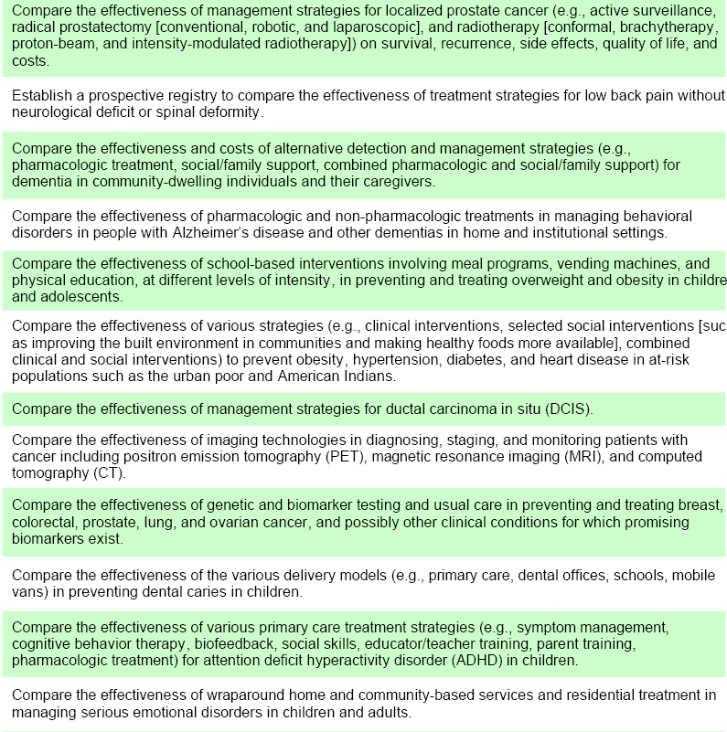
Compare the effectiveness of management strategies for ductal carcinoma in situ (DCIS)
Establish a registry to compare the effectiveness of treatment strategies for low back pain

Slide 16
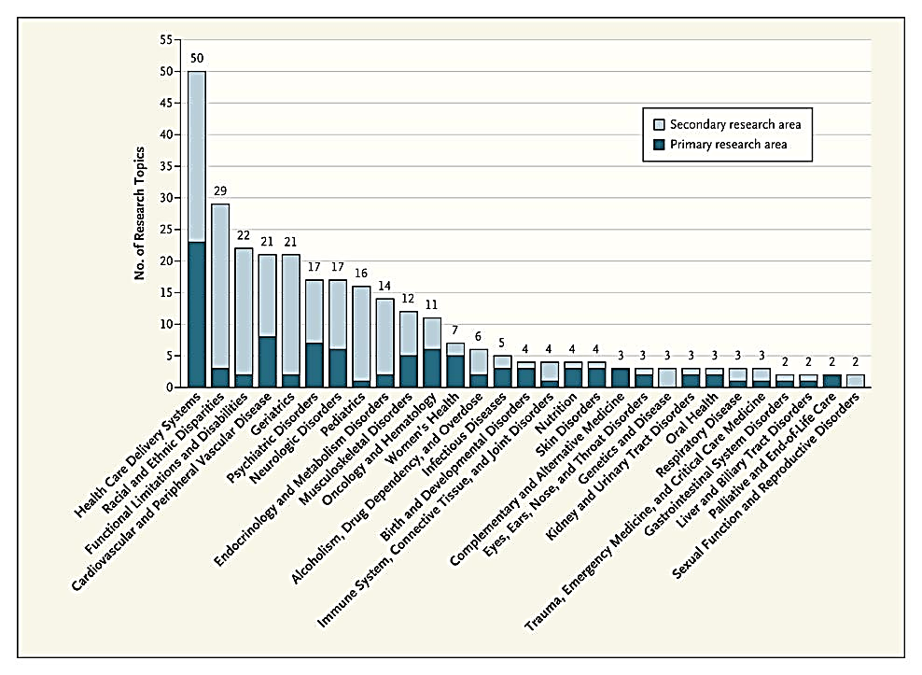
Health care delivery systems

Slide 17
Who funds this research?
Agency for Healthcare Research and Quality (AHRQ) | Health systems
Patient Centered Outcomes Research Institute (PCORI) | National Institutes of Health (NIH)
Veterans Affairs | Foundations
Department of Defense | Center for Medicare and Medicaid Innovations (CMMI)
Center for Disease Control and Prevention | Health Sciences Industry
Agency for Healthcare Research and Quality - AHRQ (1999)
AHRQ (in HHS) is the only federal research agency with the sole purpose of producing evidence to make health care safer; higher quality; more accessible, equitable, and affordable; and to ensure that the evidence is understood and used.
Committed to training the next generation of comparative effectiveness researchers.
Patient Centered Outcomes Research Institute (2010)
PCORI funds research that will help patients choose healthcare options that best meet their needs.
Funds research that advances the quality and relevance of the evidence concerning how disease can effectively be diagnosed, treated, monitored and managed.
Notes:
National Center for Health Services Research started when Medicare was initiated – eventually became AHRQ
Notable health systems conducting research: Kaiser Permanente, Intermountain Healthcare, Geisinger Health System

Slide 18
Highlighting some comparative effectiveness research and its impact
Notes:
To convey a sense of the type of research that would be considered CER

Slide 19
Comprehensive Unit-based Safety Initiatives
AHRQ invested in Dr. Peter Pronovost’s Comprehensive Unit-based Safety Initiative (CUSP) in 2003
He asked … is there a better way to prevent central line infections than what we are doing?
http://healthaffairs.org/blog/2013/09/23/a-national-initiative-to-reduce-central-line-associated-bloodstream-infections-a-model-for-reducing-preventable-harm/

Slide 20
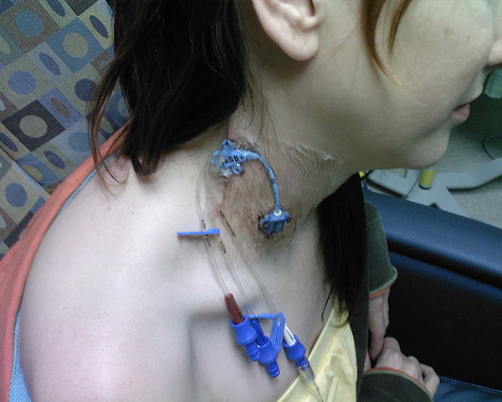

Slide 21
Comprehensive Unit-based Safety Initiatives
The program saved more than 1,500 lives and nearly $200 million in its first 18 months just in Michigan.
Collectively, more than 1,100 hospitals and 1,800 CUSP teams nationwide participated in a national initiative based on Dr. Pronovost’s research to eliminate catheter line infections.

Slide 22
Evidence-based Practice Centers
Since 1998, EPCs have produced >500 comprehensive systematic literature reviews
Used as the evidence
To support the U.S. Preventative Services Task Force recommendations
To support professional society guidelines
To inform NIH consensus conferences
To inform CMS coverage decisions

Slide 25
Key Research Methodologies
Evidence synthesis with systematic literature reviews and decision- analysis
Evidence generation with experimental and observational methods
Stakeholder engagement methods
Dissemination and implementation methods
Annual Review of Public Health Volume 33, 2012
Sox and Goodman pp 425-445

Slide 26
Generates Important Results for Medical Practice
From VA's Surgical Quality Improvement Program (VASQIP)
Is bariatric surgery more effective at preventing deaths than usual care (no surgery) in morbidly obese veterans?

Slide 27
Investigators identified 2,500 Veterans (74% male) who underwent bariatric surgery in VA bariatric centers
JAMA. 2015;313(1):62-70
Notes:
Surgical patients lower all-cause mortality starting at 5 years and up to 14 years following the procedure than matched controls

Slide 28
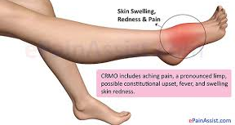
Generates Important Results for Medical Practice

Slide 29
Are oral antibiotics as good as intravenous antibiotics after hospital discharge?
Children treated with antibiotics by mouth did NOT have more treatment failures than those treated with antibiotics intravenously.
Far fewer adverse events requiring trips to the emergency room.

Slide 30
Pragmatic Trial Infrastructure
PCORNet
Clinical Data Research Networks (CDRNs) are system-based networks that originate in healthcare systems
Patient-Powered Research Networks (PPRNs) are networks operated and governed by groups of patients and their partners.
Notes:
They aren’t the only one: the NIH Collaboratory funded by NIH’s common fund

Slide 31
Example:
PaTH is a Clinical Data Research Network comprised of:
Geisinger Health System
Johns Hopkins
Penn State College of Medicine
Temple University’s Lewis Katz School of Medicine
University of Pittsburgh
University of Utah

Slide 32
ADAPTABLE, the Aspirin Study
ADAPTABLE (Aspirin Dosing: A Patient-centric Trial Assessing Benefits and Long-Term Effectiveness): 3 year pragmatic trial to compare the effectiveness of different doses of aspirin to prevent heart attacks and strokes in individuals living with heart disease
Embeds the trial into the usual healthcare setting, and leverages data from health systems to produce results that can be readily used to improve patient care.
81
325

Slide 33
What Outcomes are Important
Clinical trials do not always measure outcomes that patients consider important or relevant.
Makes it hard to know the value of an intervention to patients
Patient-Centered Outcome Measures (PCOM) are measures that assess the impact of the disease and treatment on patients
Notes:
. Even when presented with the same information, patients may view treatment options differently and make valid, different choices

Slide 34
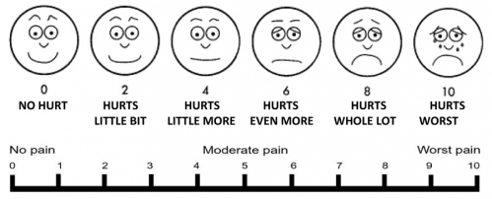
Examples
PAIN

Slide 36
Others
Survival
Out of pocket costs
Time to return to work

Slide 37
PROMIS

Slide 38
Aspirin?

Slide 39
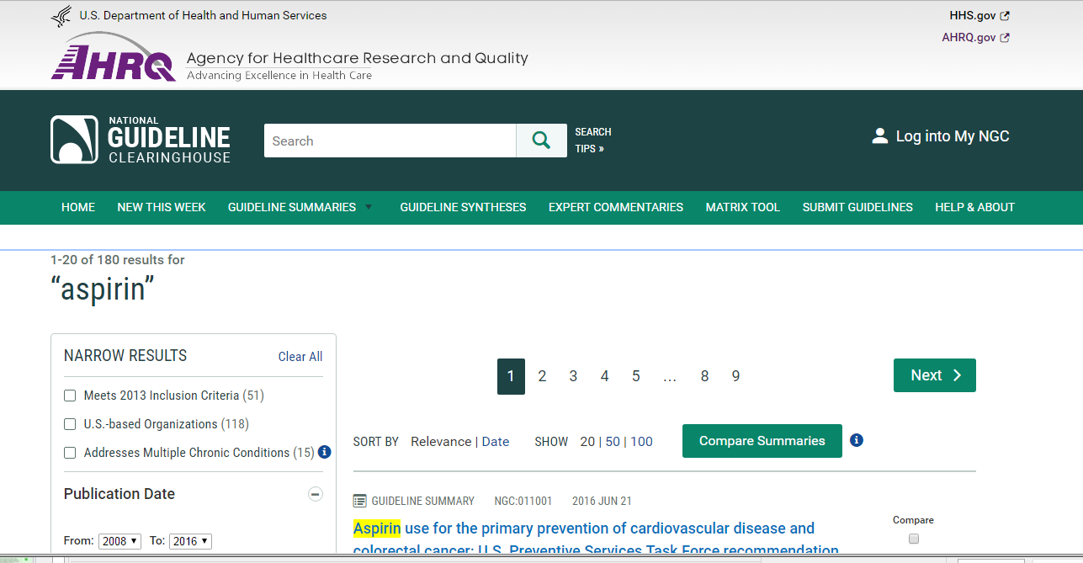
Let me find the evidence…

Slide 42
Summary
CER described in the literature since the 1950s
Pragmatic trials described in the late 1960s (in France)
Focus on health services research by the VA in the 1970s
Growing attention to CER in the 1980s with appreciation for “evidence” and rising healthcare costs
Establishment of AHRQ and later PCORI
CER recognized as the essential late part of the translational pathway to improved patient outcomes, in a sustainable healthcare system

Slide 44
PCORI Funding
PCORI is funded through the PCOR Trust Fund, which was established by Congress. The PCOR Trust Fund receives income from three funding streams:
appropriations from the general fund of the Treasury ($120M in FY15)
transfers from the Centers for Medicare and Medicaid trust funds ($90M in FY15), and
a $2.26 per covered person per year fee assessed on private insurance and self-insured health plans ($210 M in FY15)

